Slide 1
A phylogeny-based analysis of bioactive metabolites in Scutellaria reveals multiple species with significant medicinal potential
Bryce Askey¹, Yeong Hun Song¹, Yoonkyung Lee², Ru Dai¹, Sangtae Kim², and Jeongim Kim^{1,3}
¹Horticultural Sciences Department, University of Florida, Gainesville, FL, USA
²Department of Biology, Sungshin Women’s University, Seoul, Republic of Korea
³Plant Molecular and Cellular Biology Graduate Program, University of Florida, Gainesville, FL, USA

Slide 2
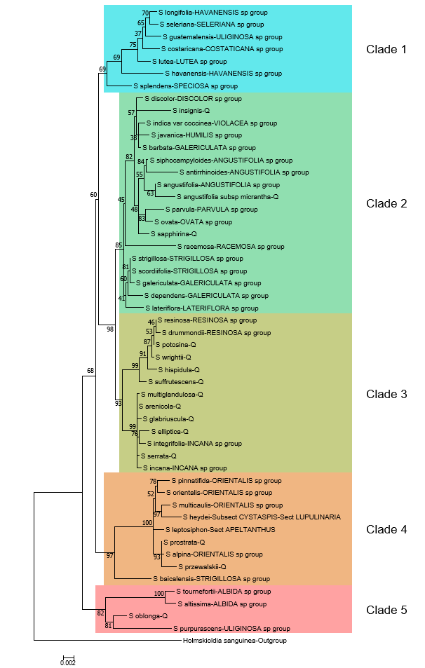
Figure 1. Maximum likelihood phylogenetic tree inferred from 3 chloroplast genome regions for 51 species of Scutellaria and 1 outgroup. To facilitate downstream analysis, the tree is subdivided into 5 color-coded clades based on grouping of species within the tree.

Slide 3
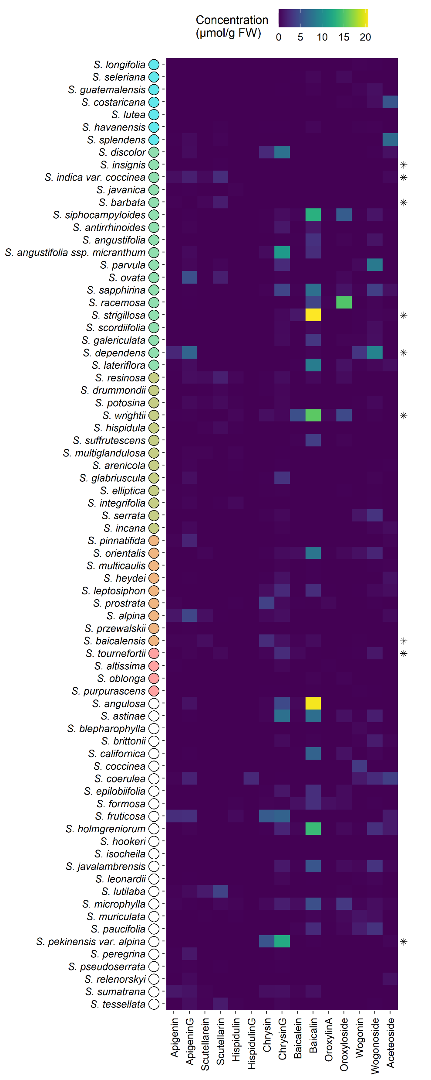
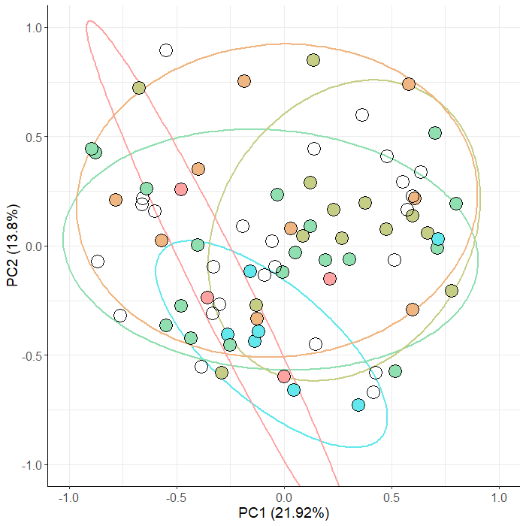
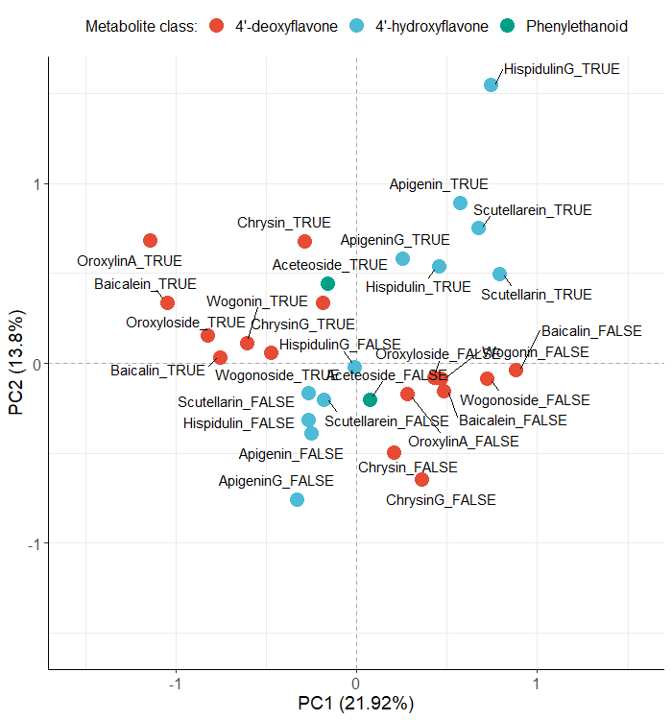
A.
B.
C.
Figure 2. Aerial metabolite concentrations measured with High Performance Liquid Chromatography (HPLC) compared to phylogeny for 76 species of Scutellaria. (A) Heatmap of collected data. Data is shown in units of µmol/g fresh weight. Fresh weight of herbarium samples was estimated by multiplying their dry weight by a factor of 10. Species for which fresh tissue was used are indicated by an asterisk on the right side of the heatmap. Samples for all other species were prepared from herbarium vouchers. Colored circles next to species names indicate phylogenetic clade, as shown in Figure 1. An empty circle indicates that the species was not included in the tree from Figure 1. (B) Multiple Correspondance Analysis (MCA) individual results with overlaid 80% confidence ellipses generated from binarized metabolite data. Each colored circle represent a species, and the color of the circle represents phylogenentic clade, as shown in Figure 1. The percentage of total variance explained by each principal component is shown next to each axis title. (C) Variable loadings from MCA. Each variable represents the prescence (indicated with “TRUE) or absence (indicated with “FALSE) of a metabolite, and are color-coded according to metabolite class.

Slide 4
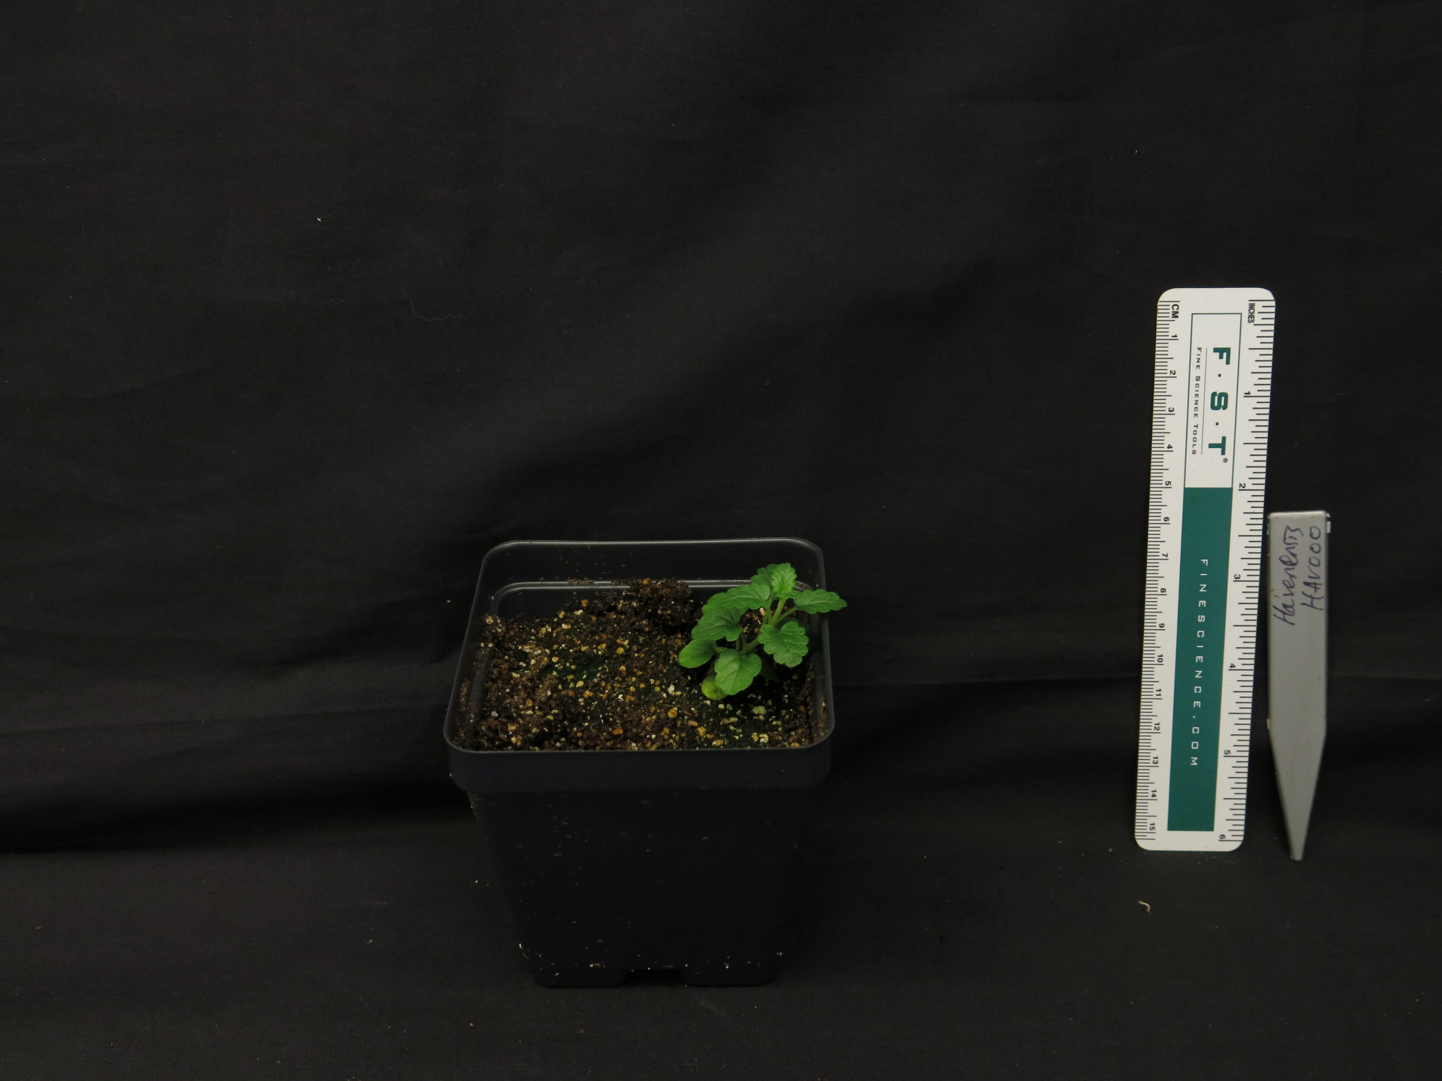
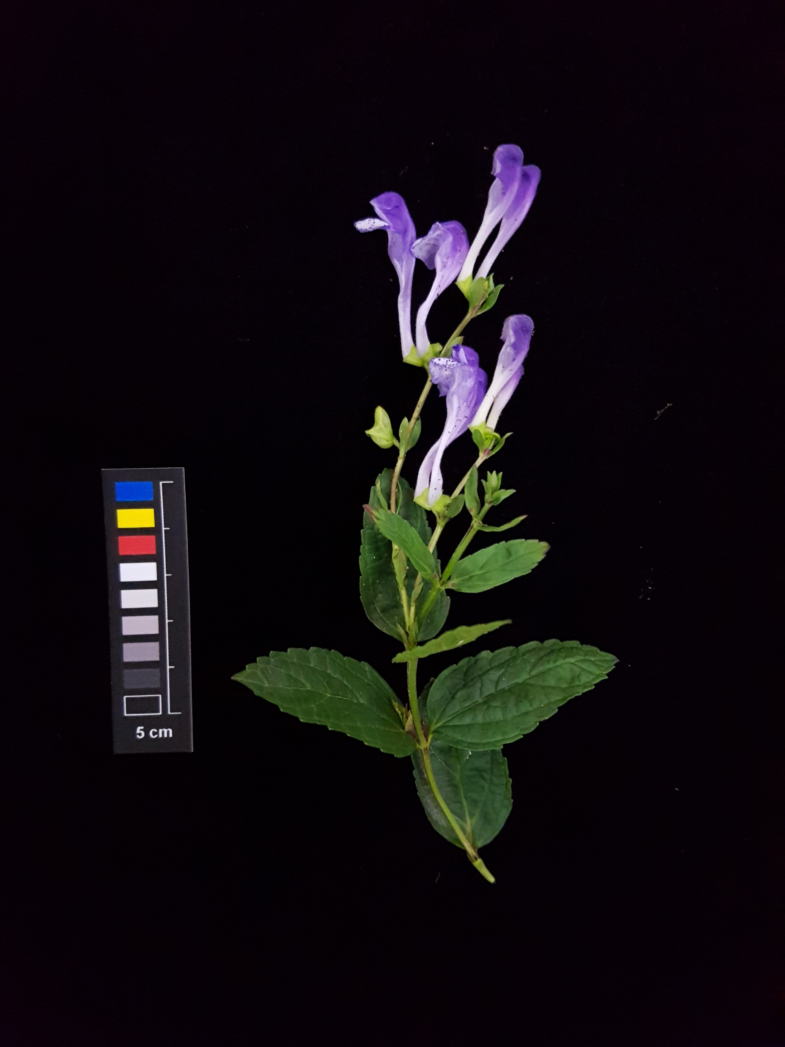
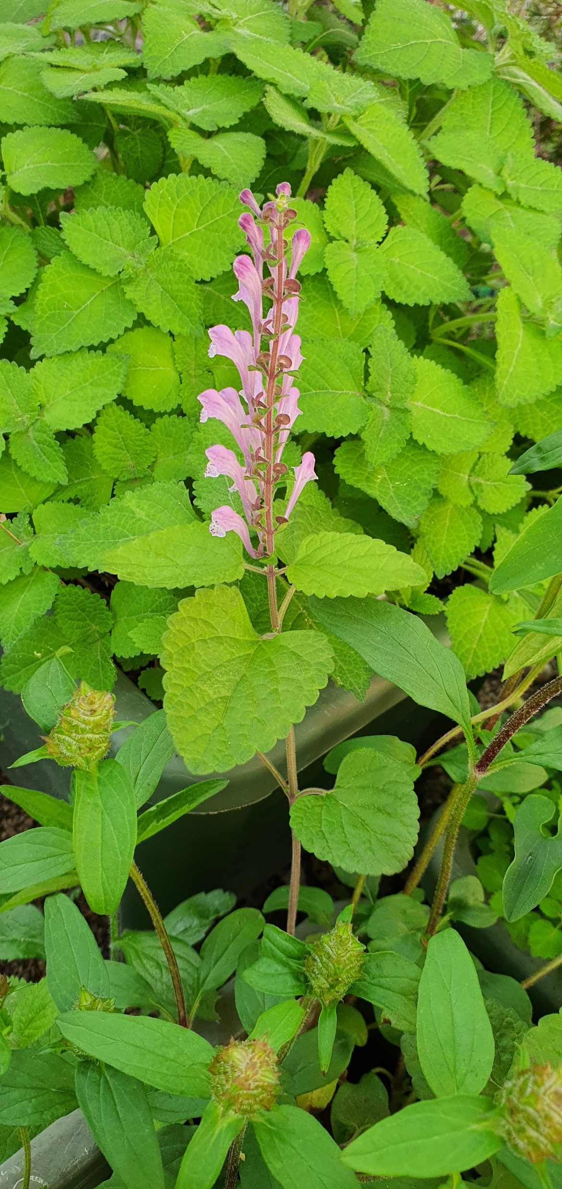
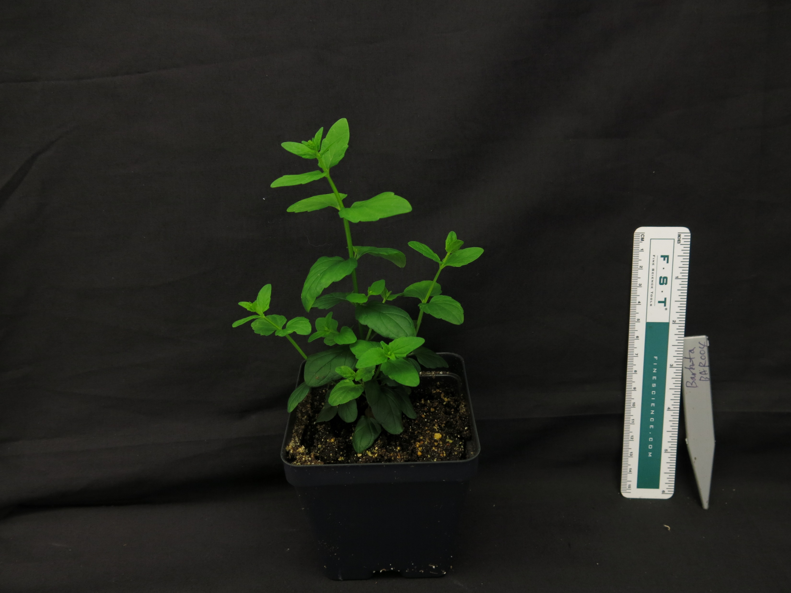
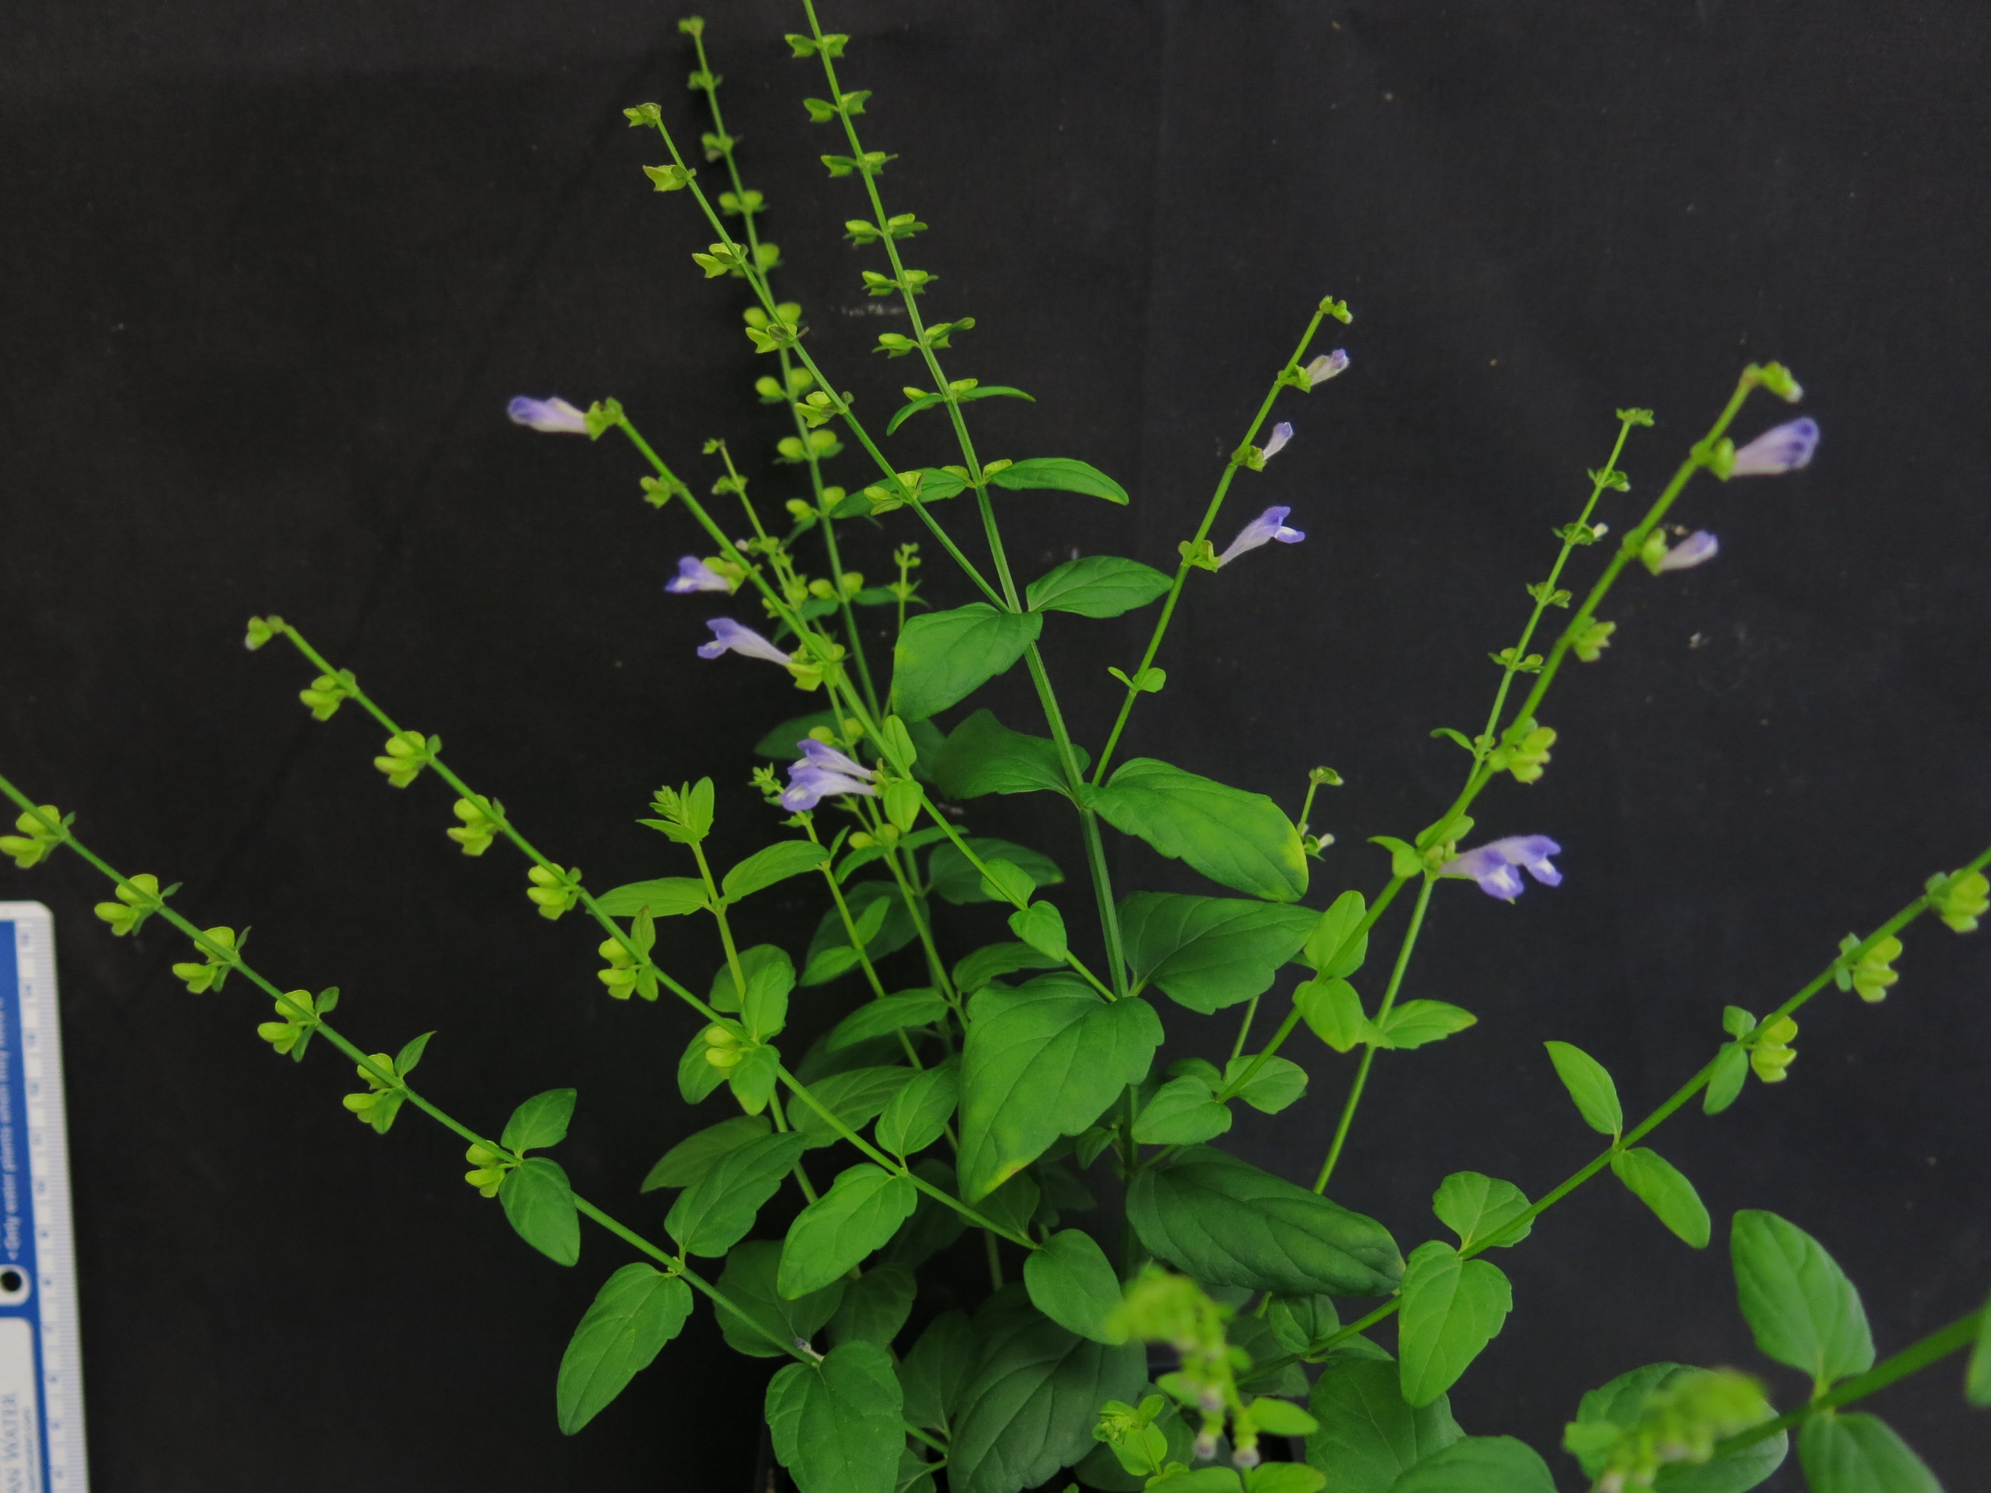
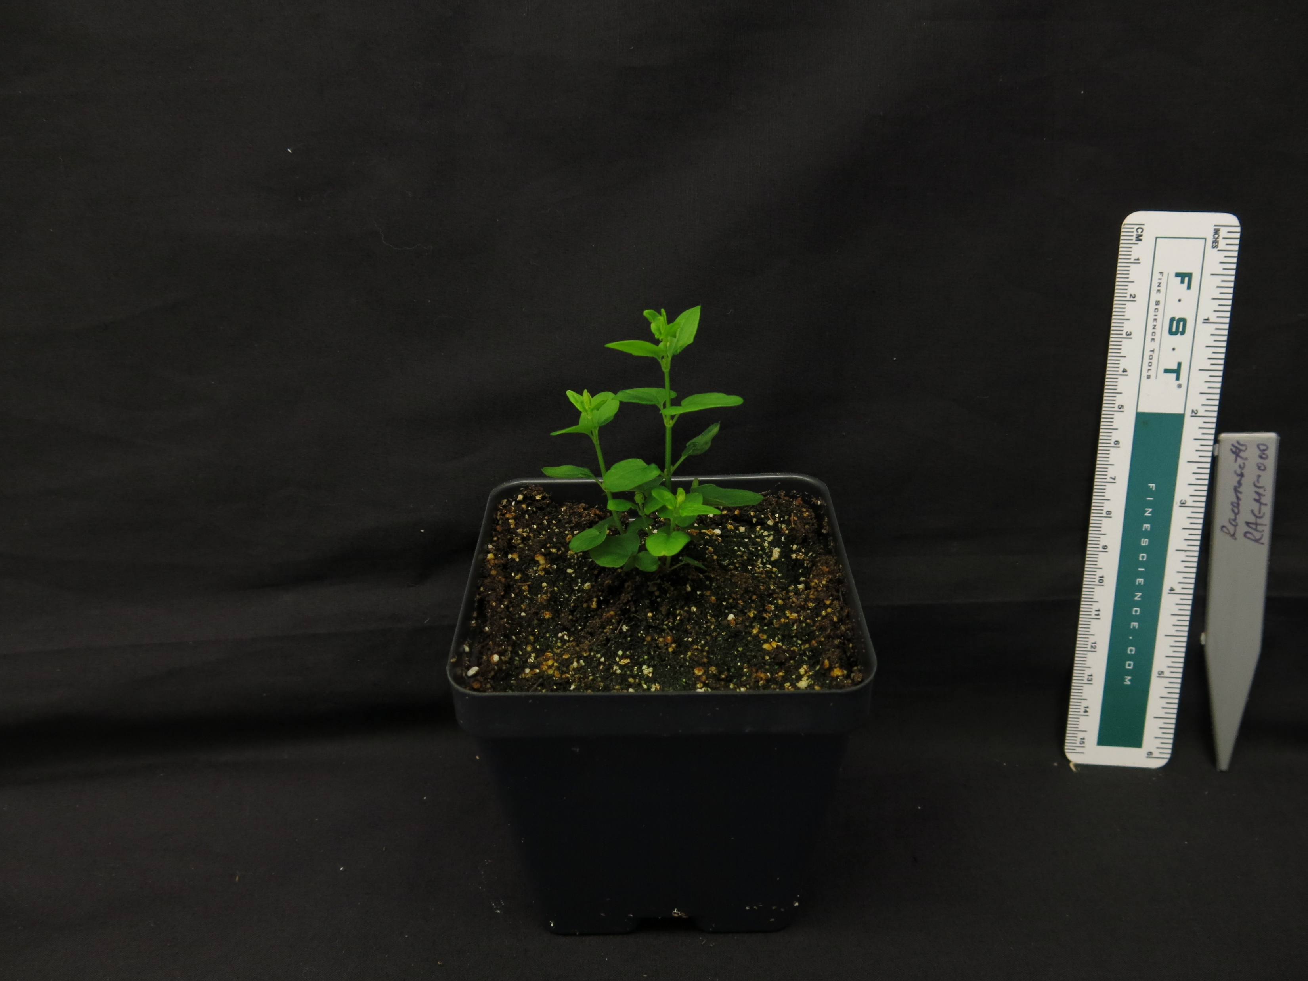
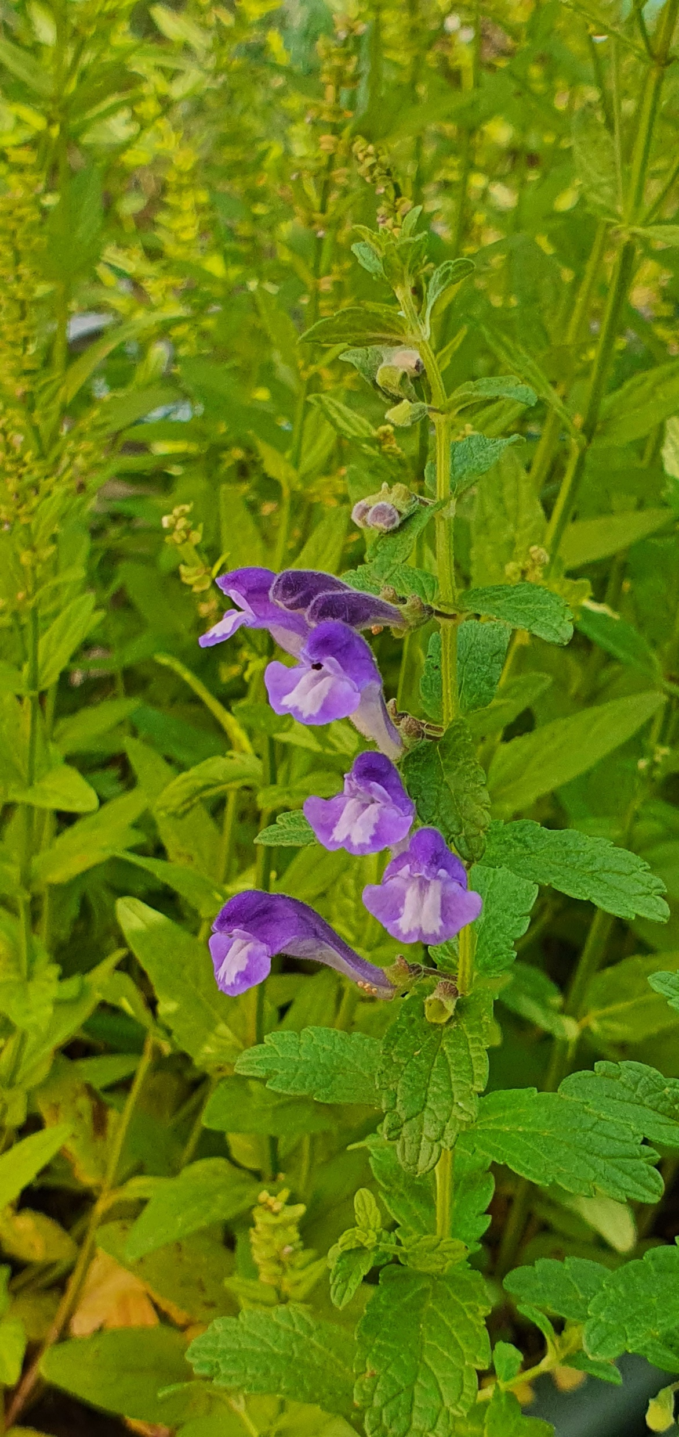
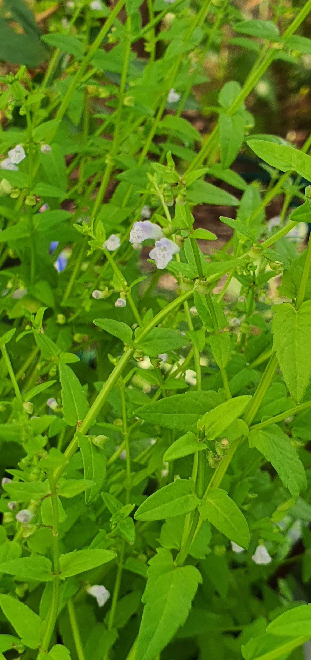
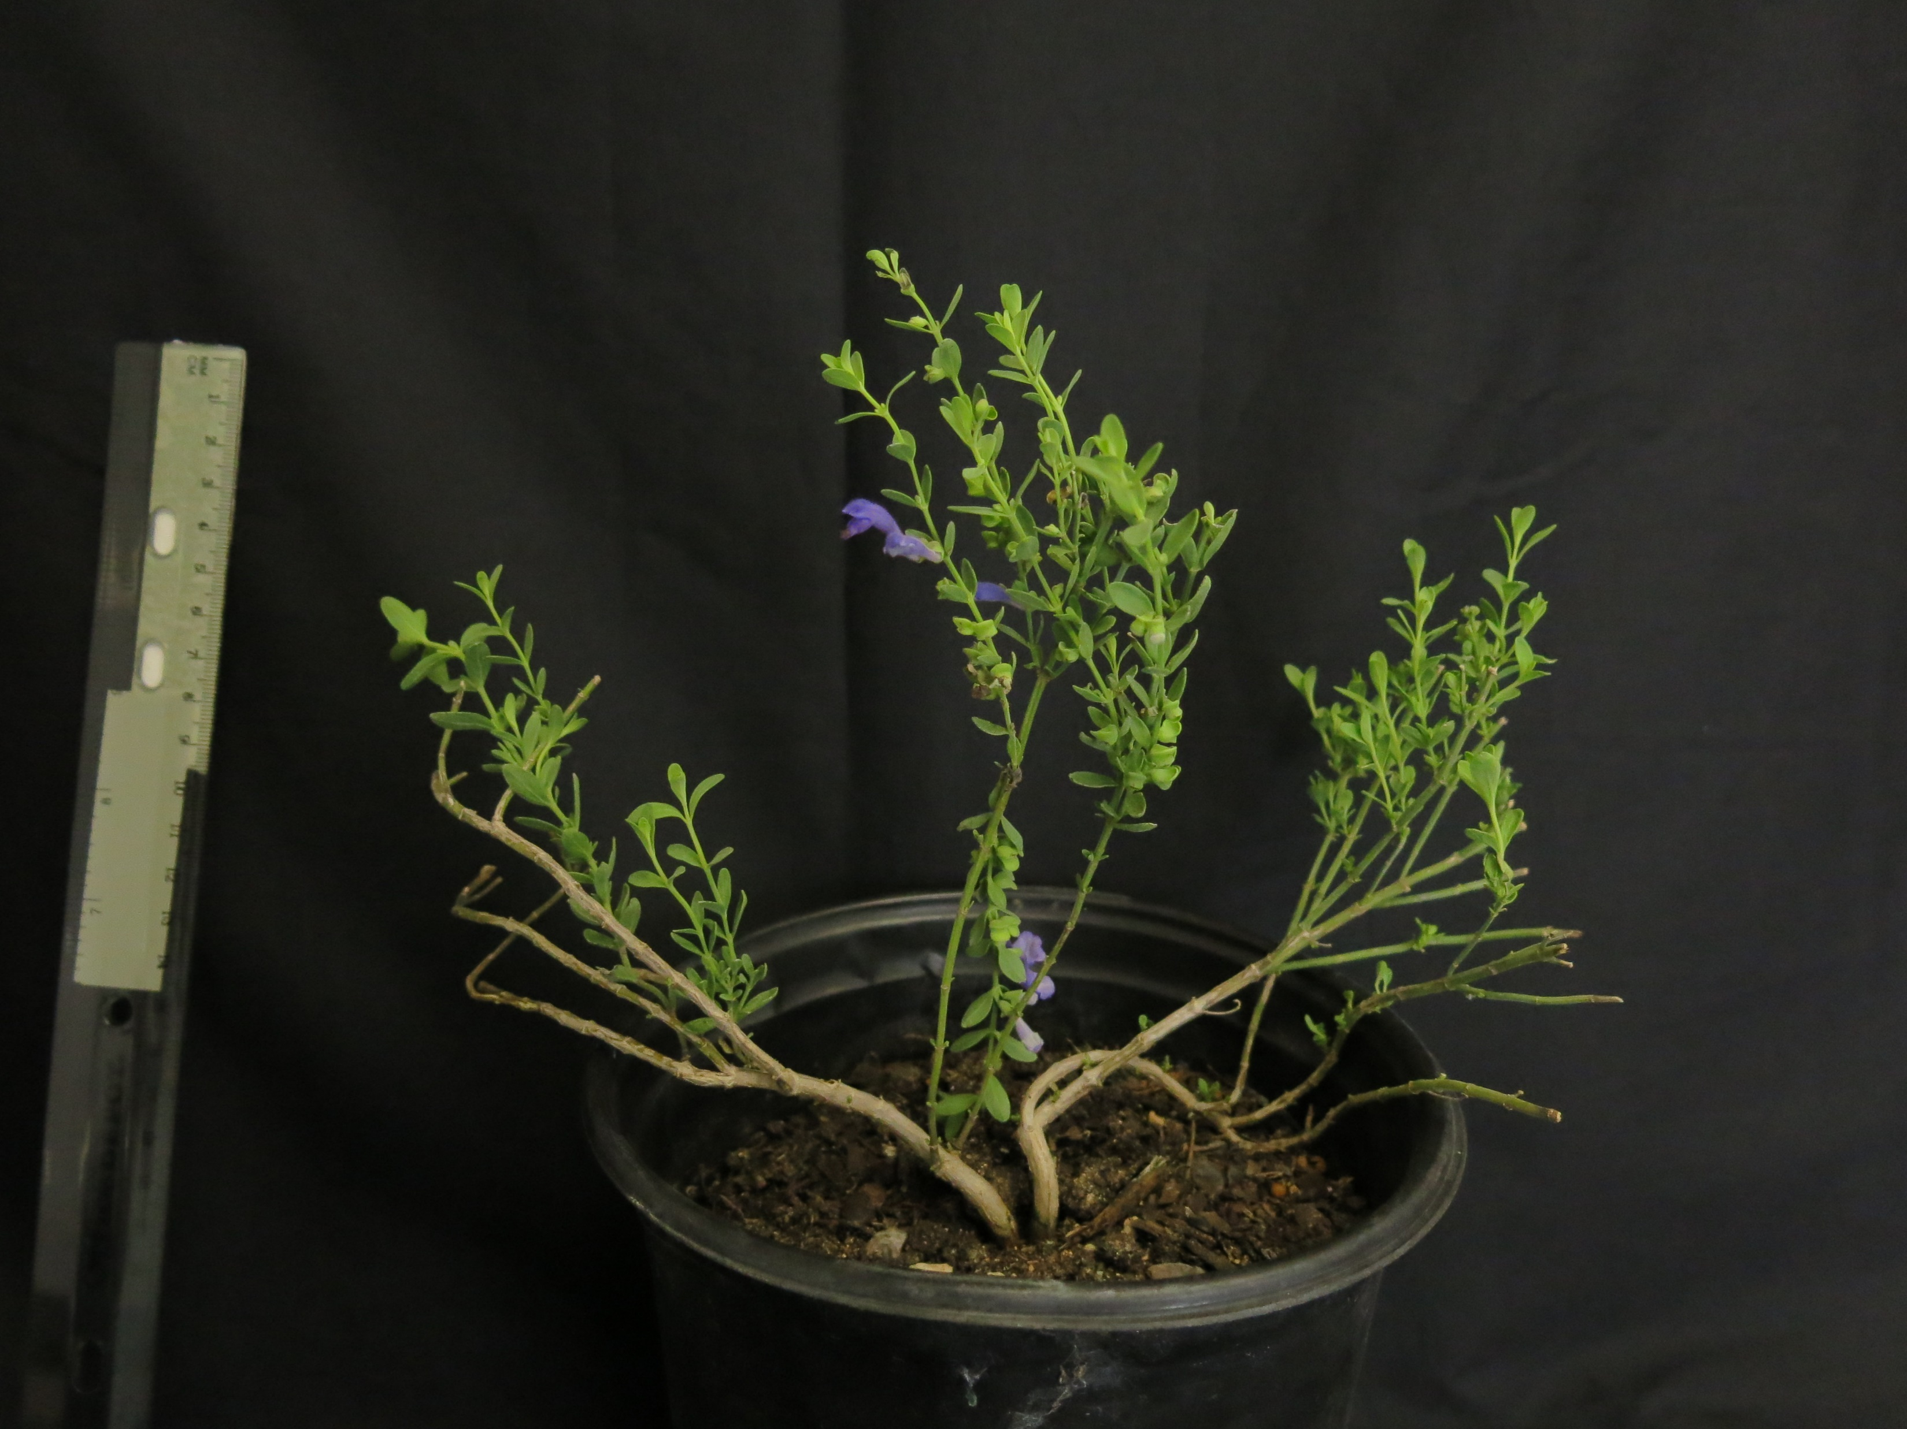
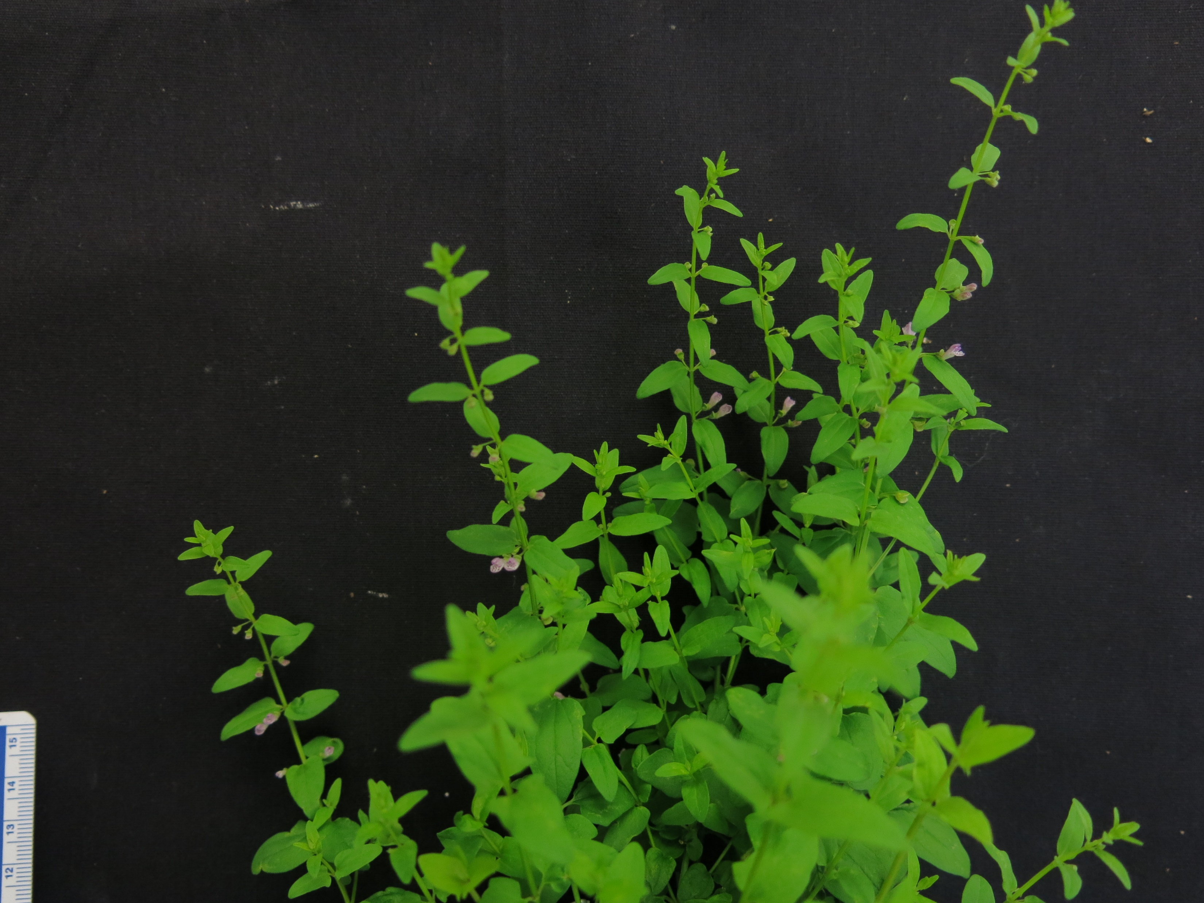
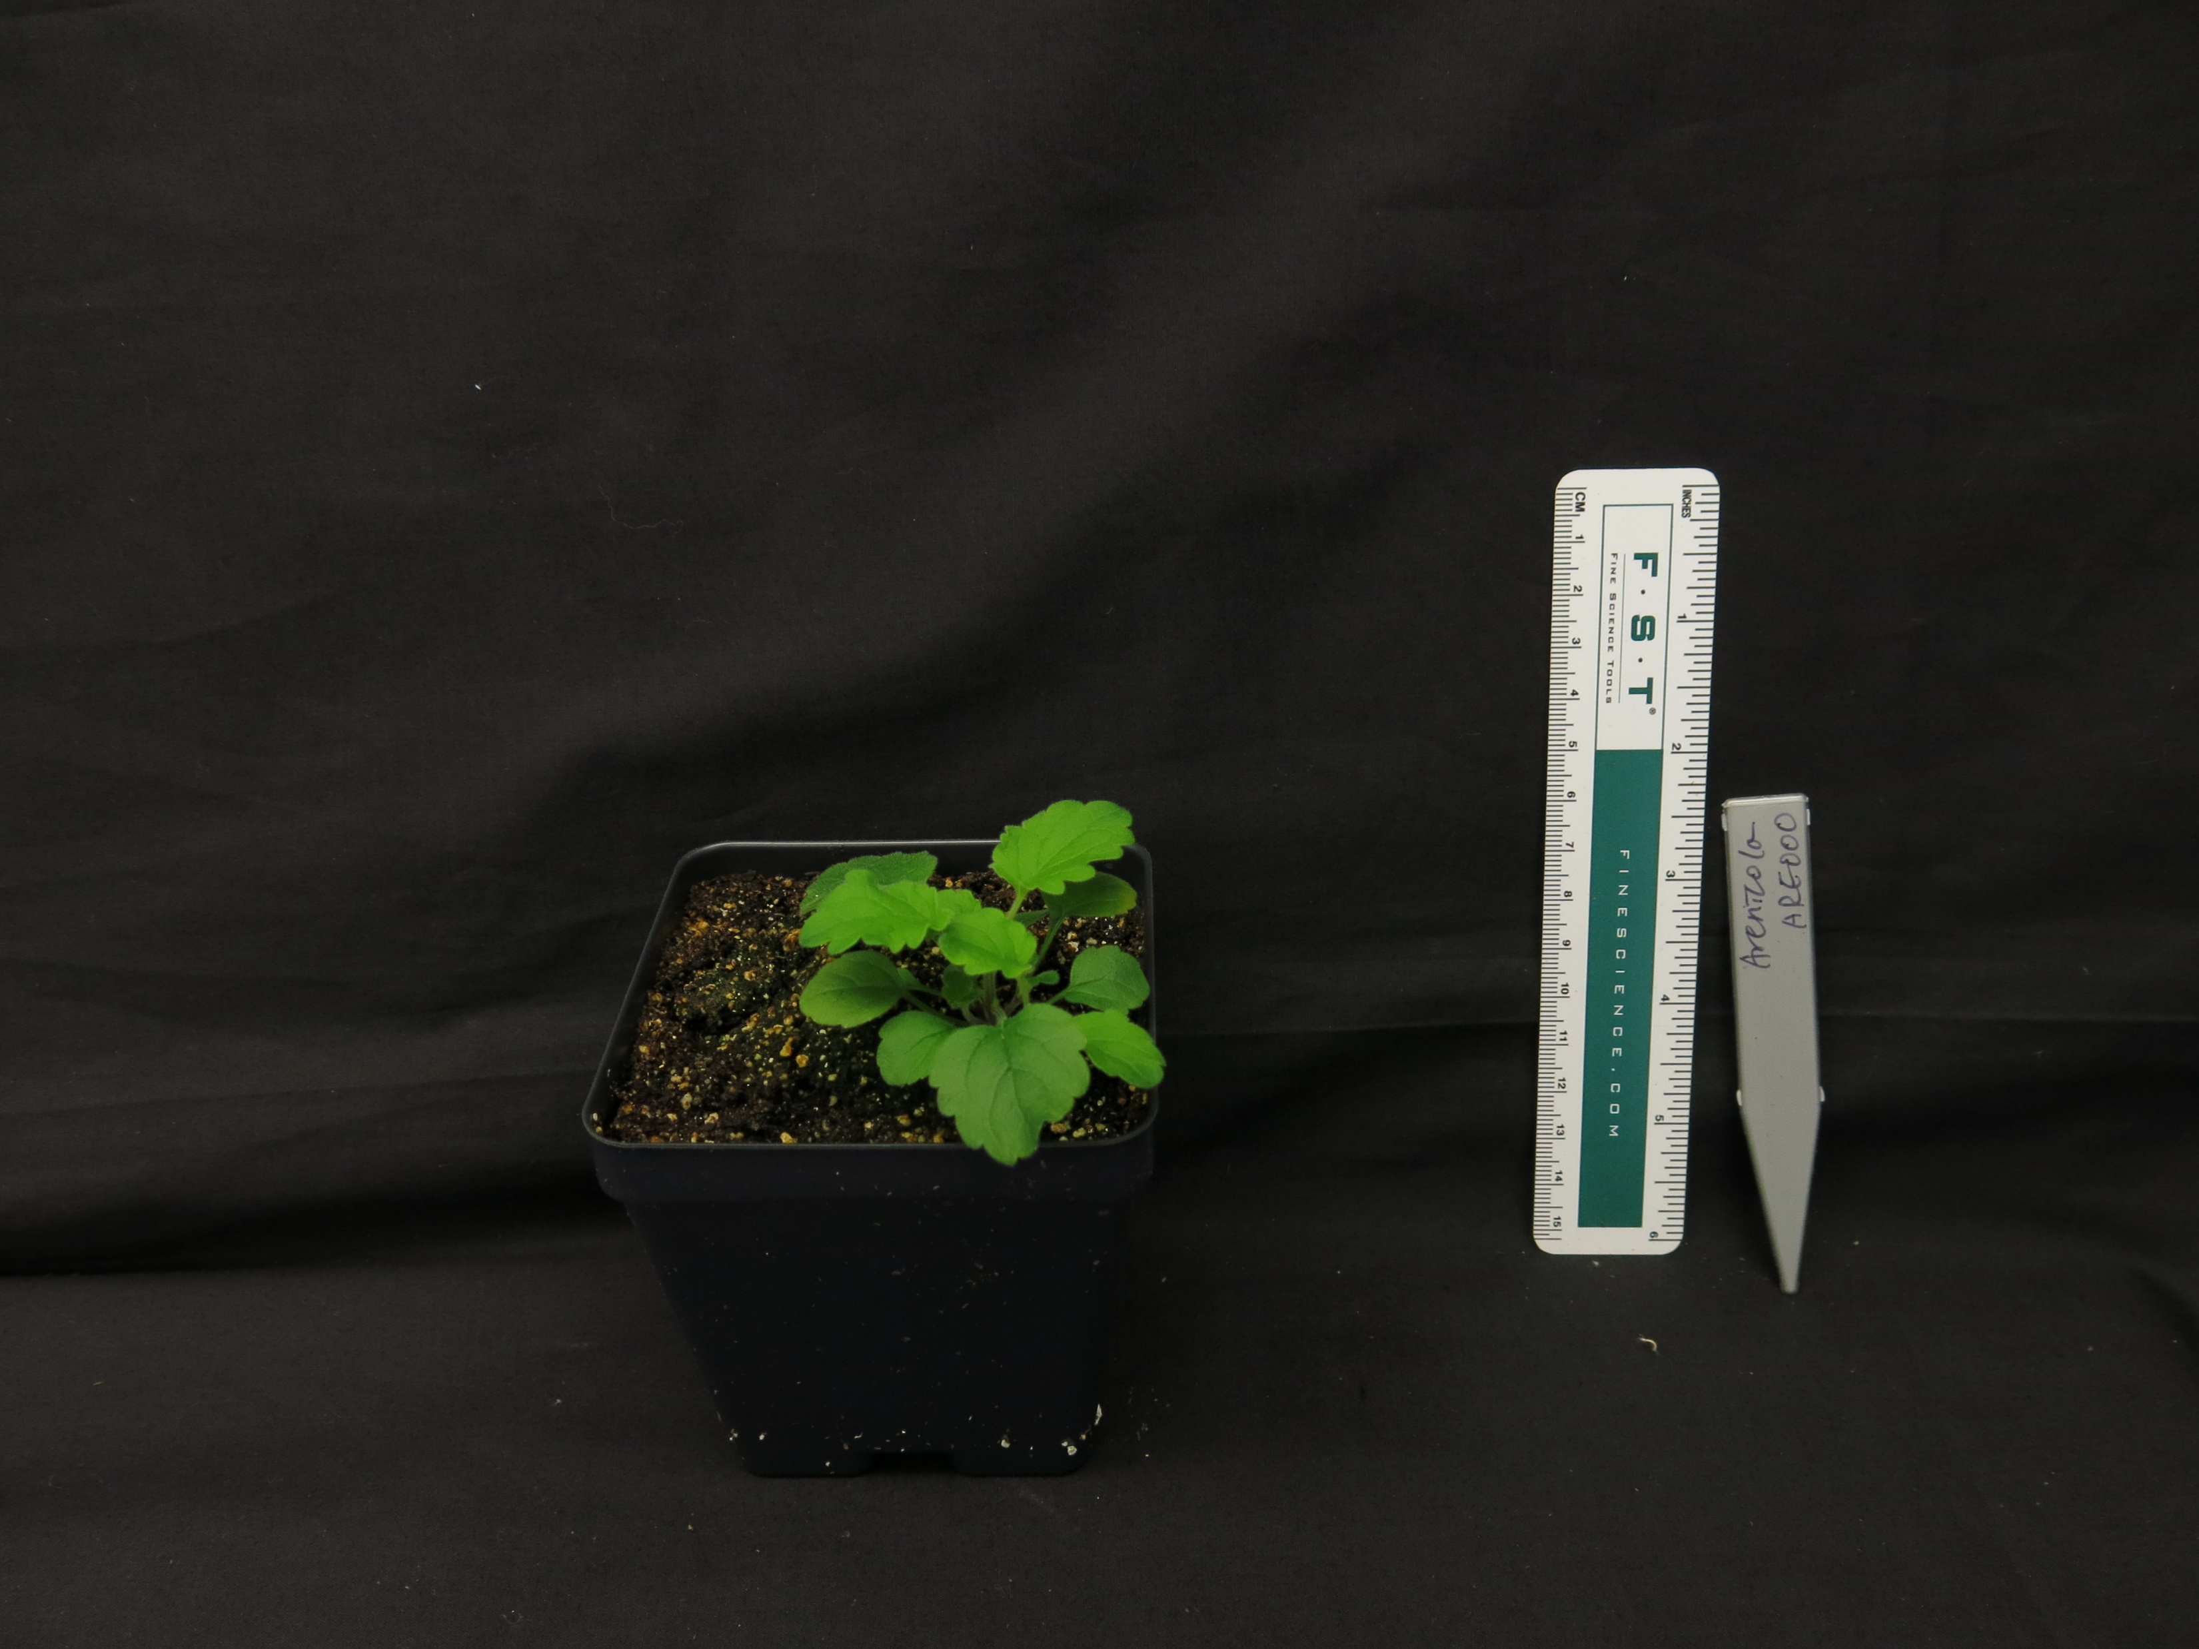
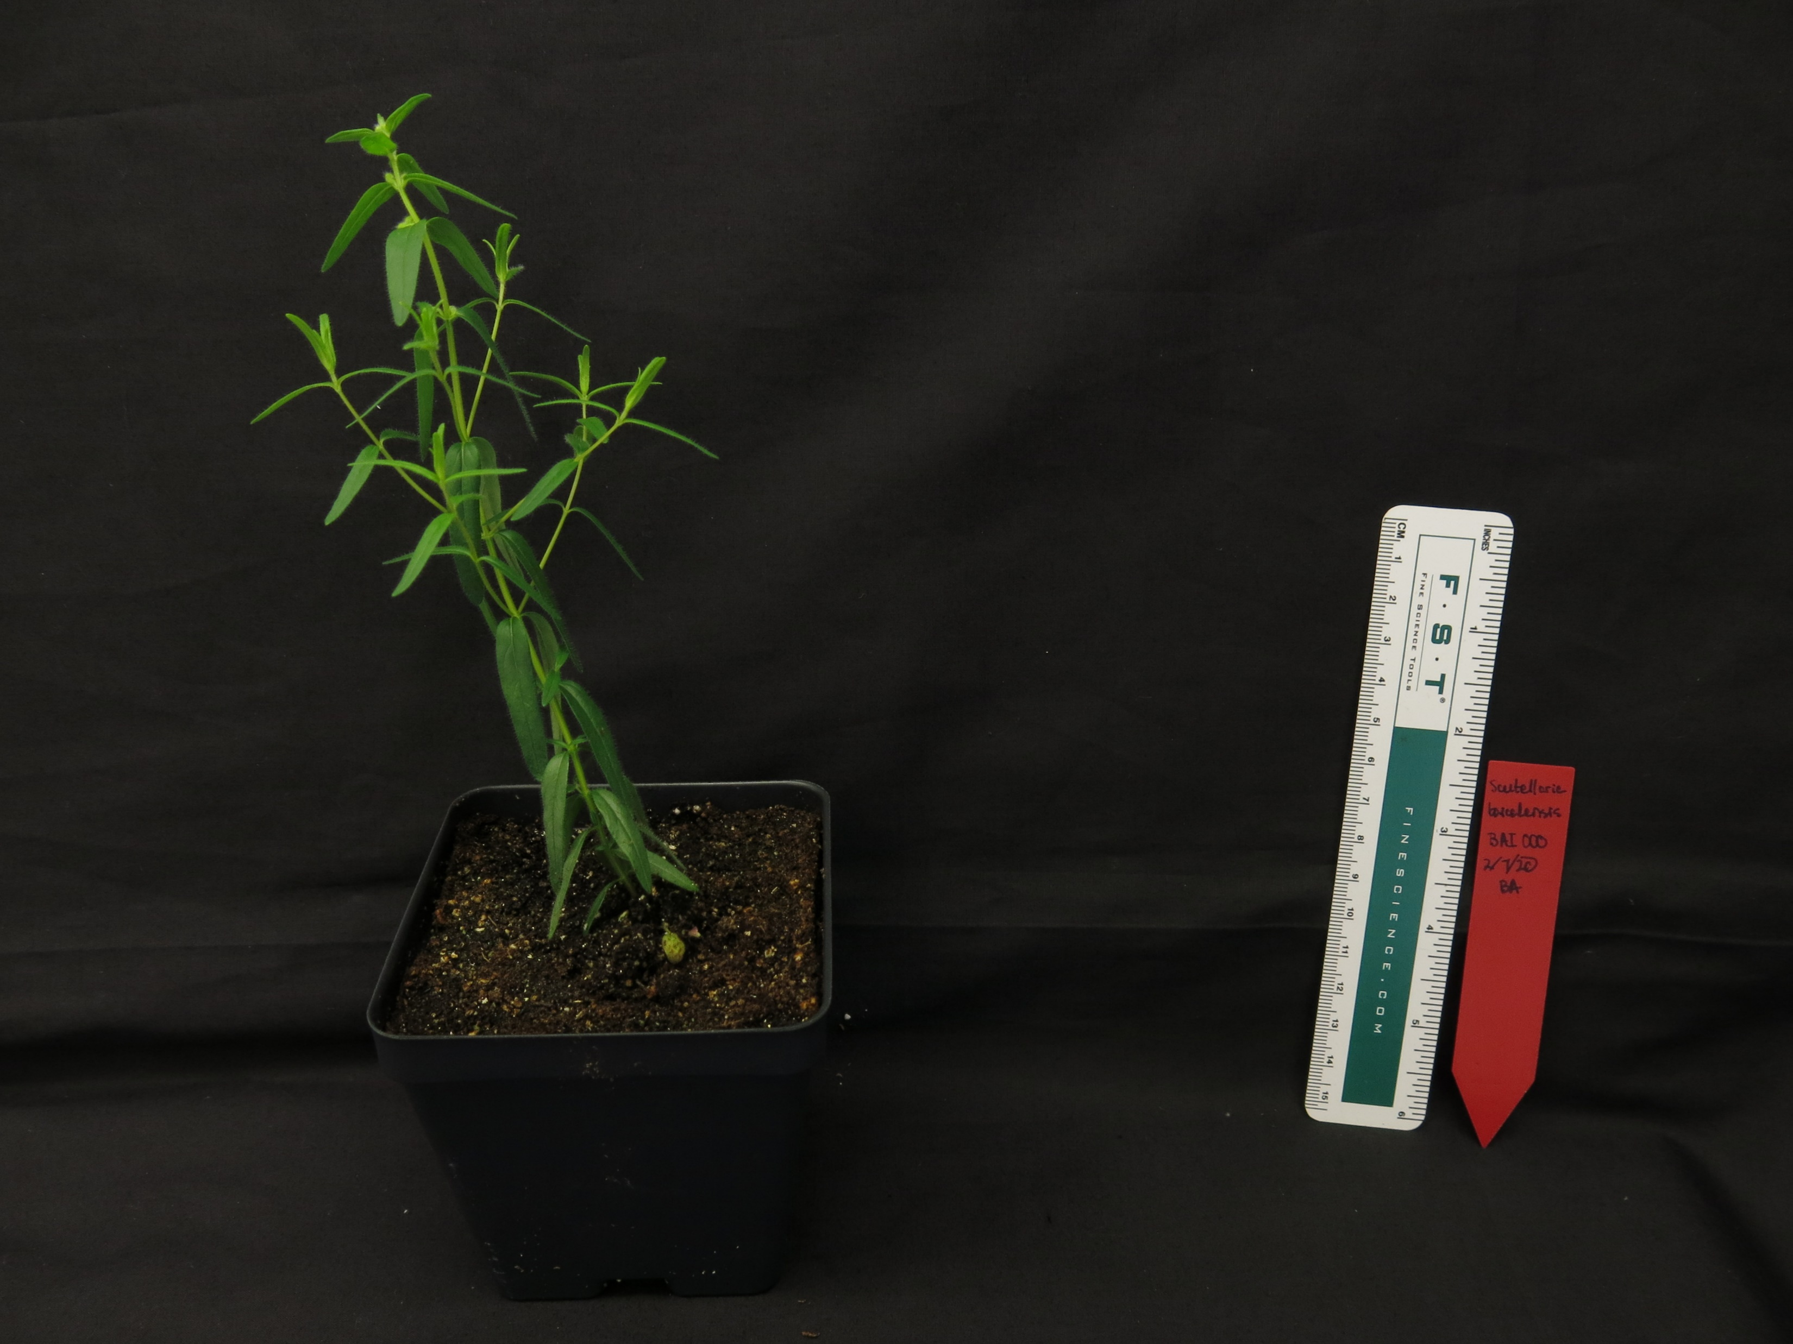
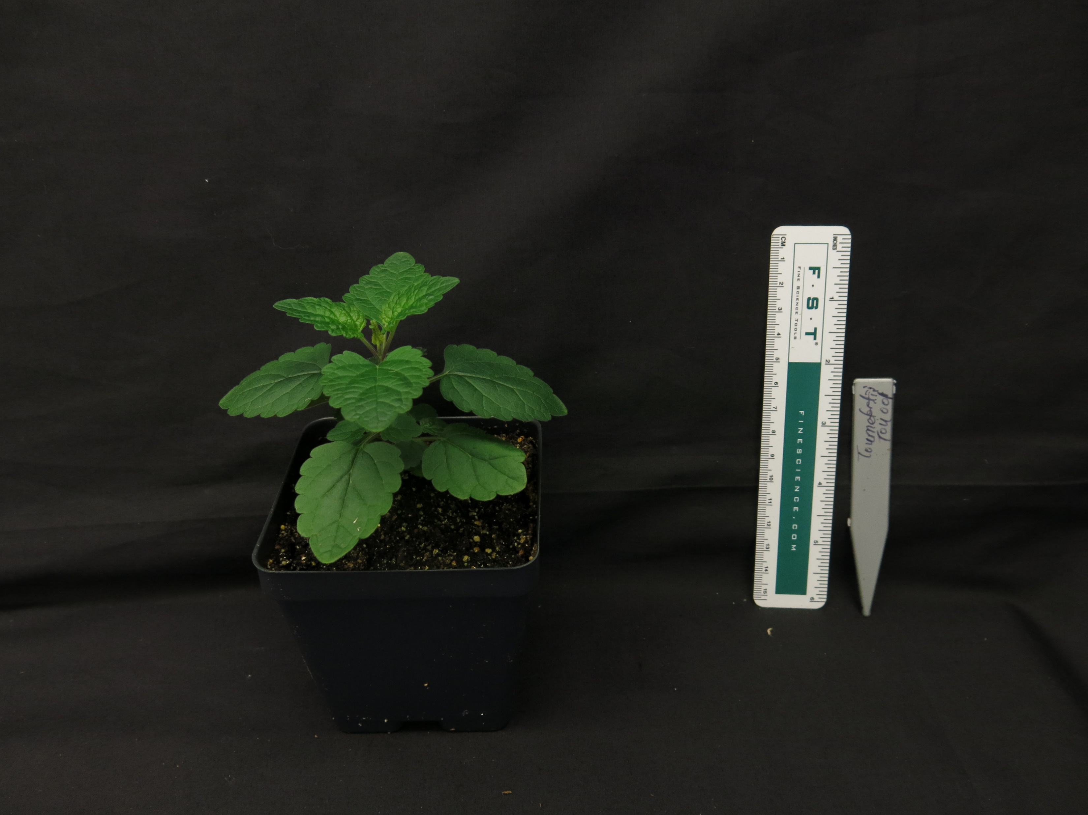
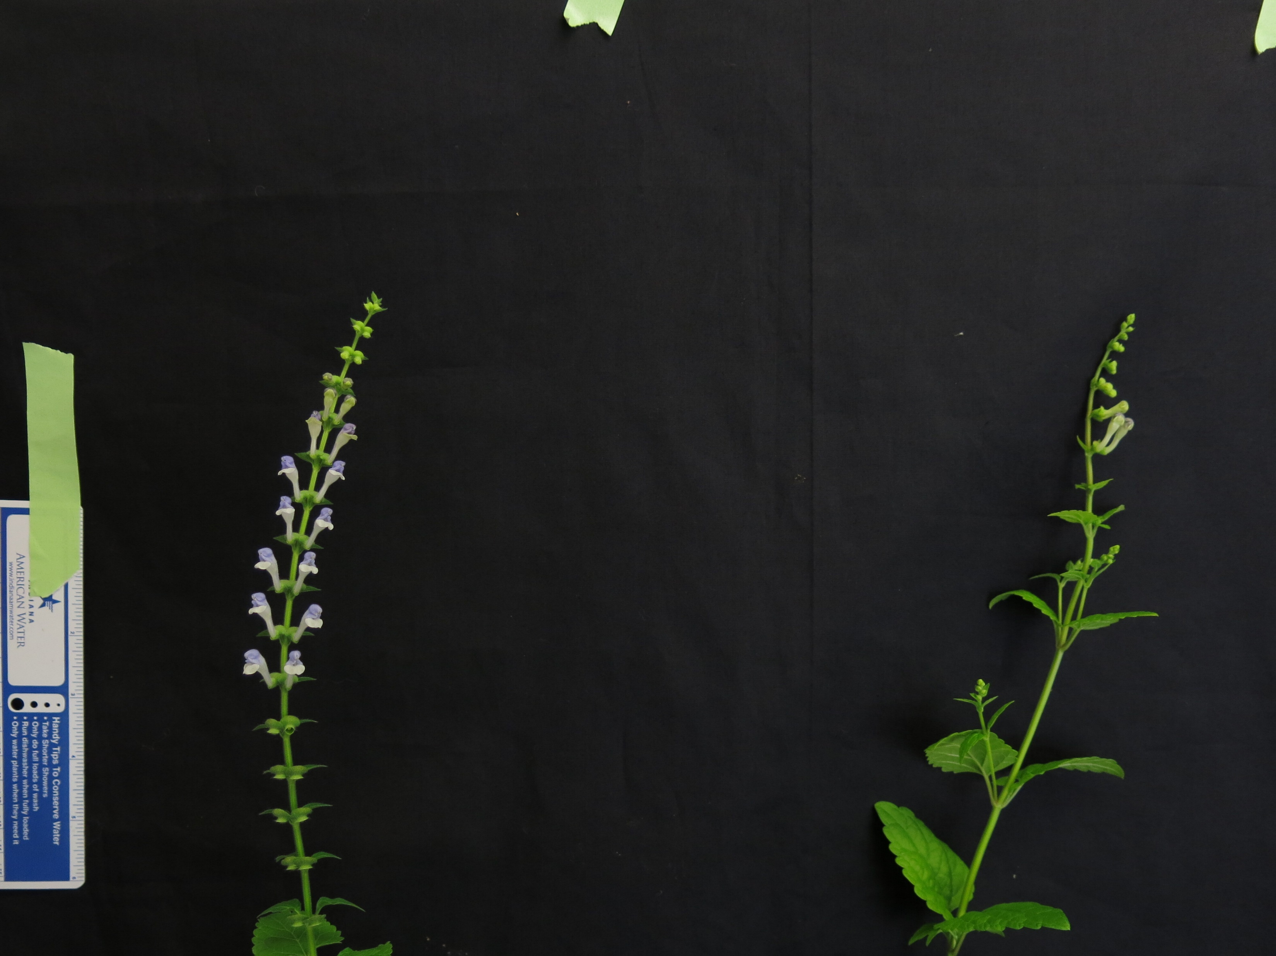
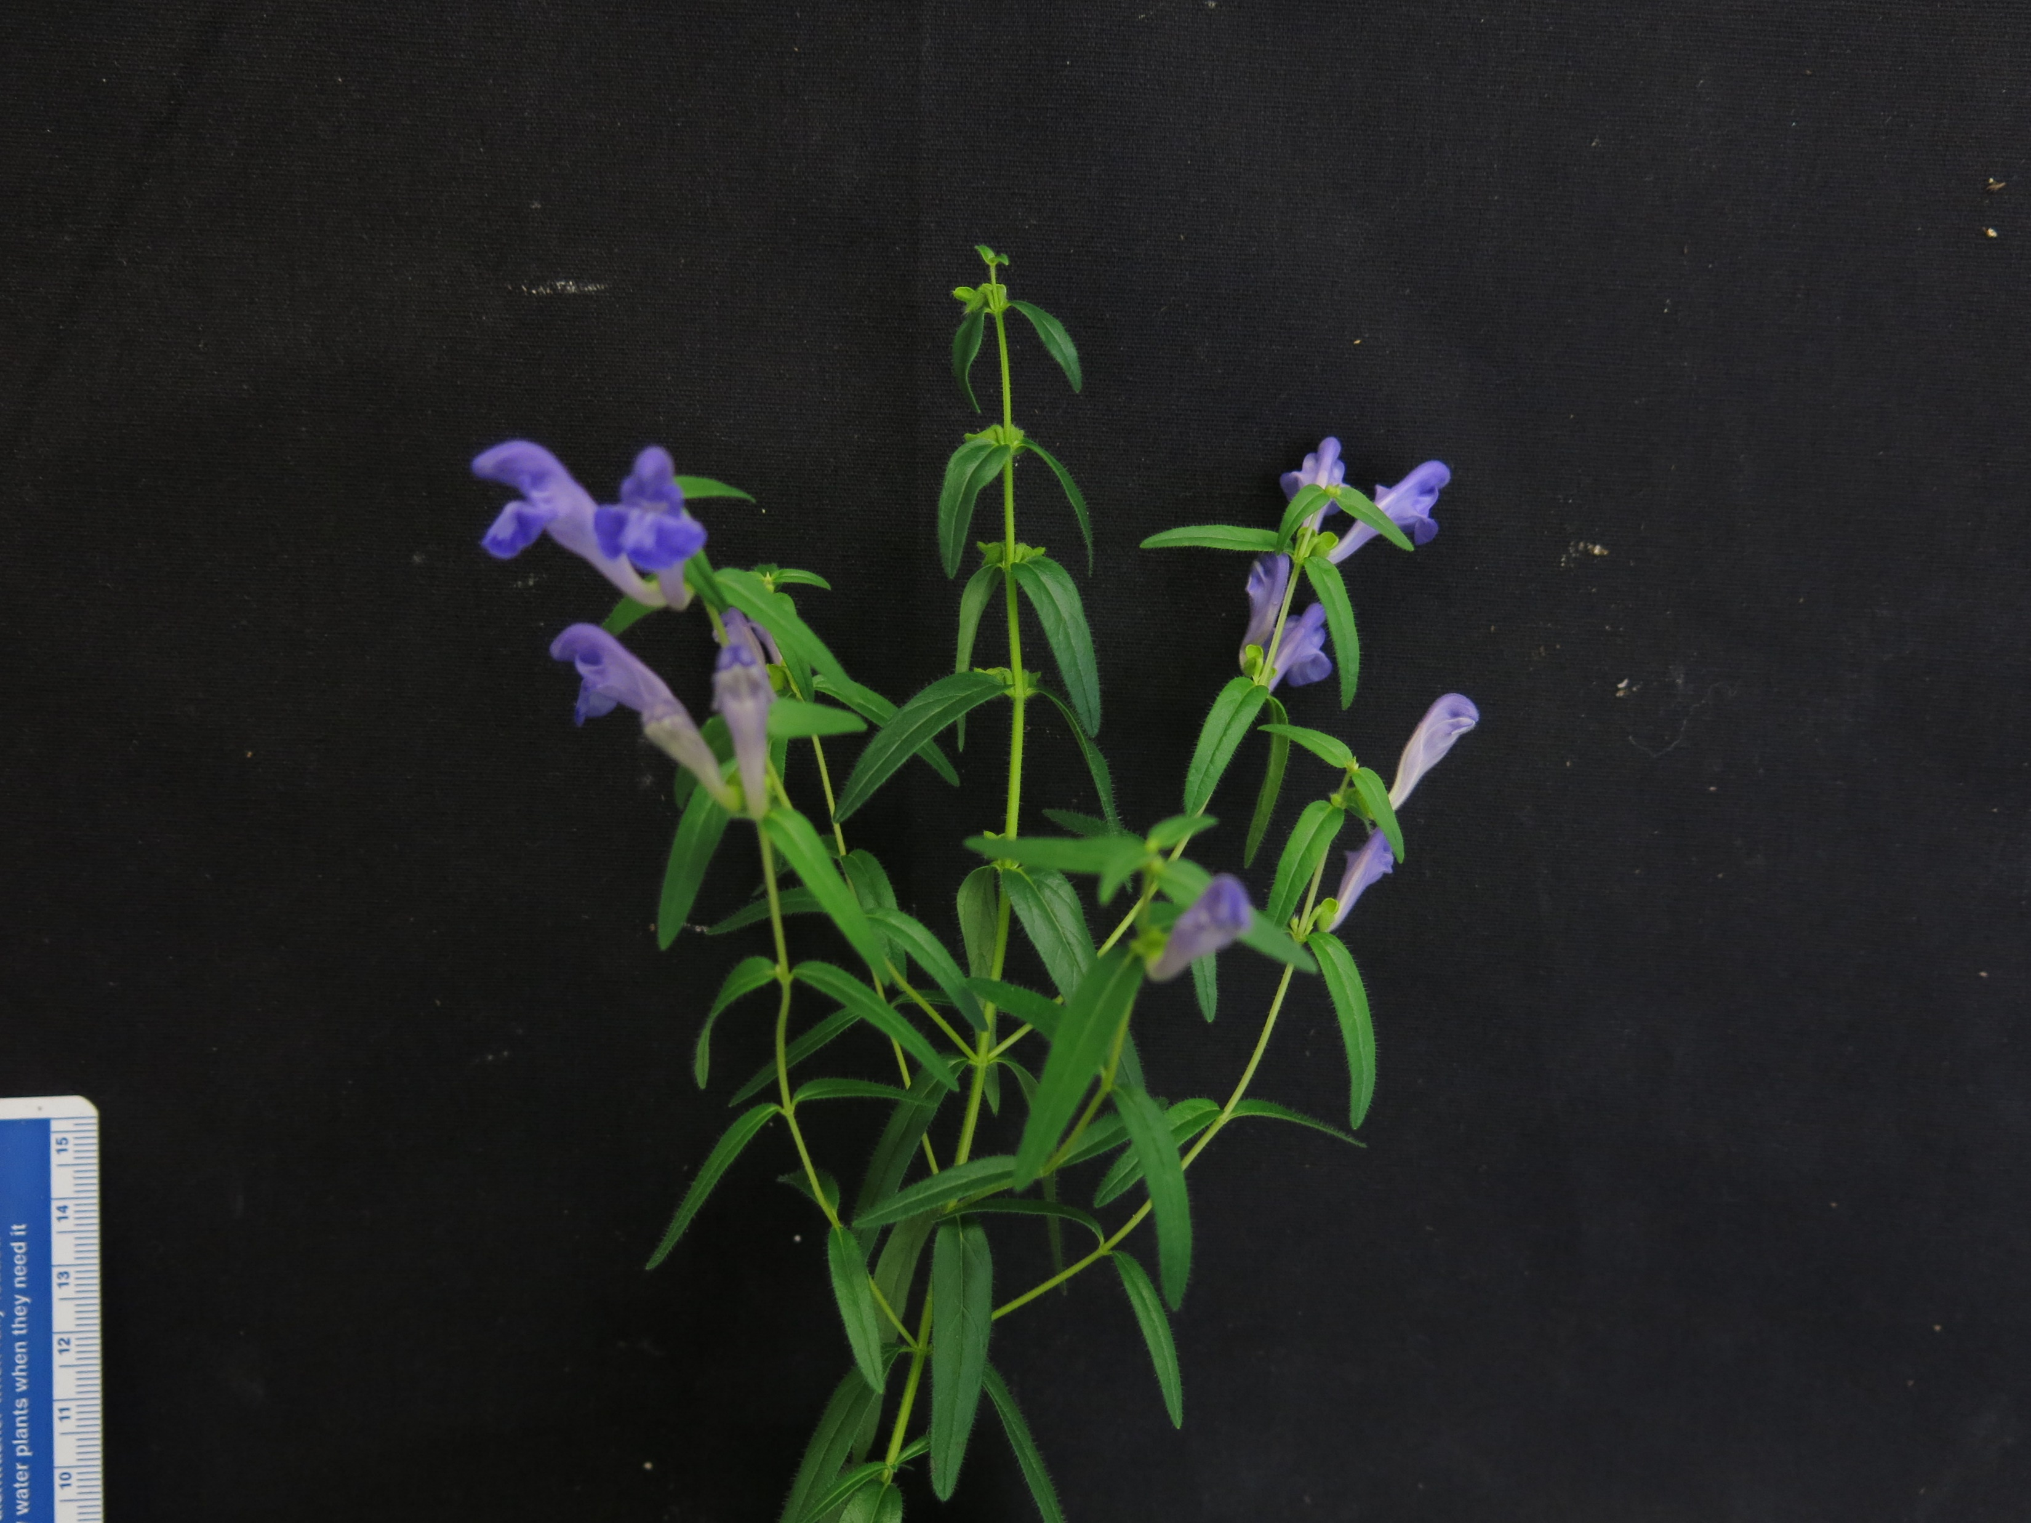
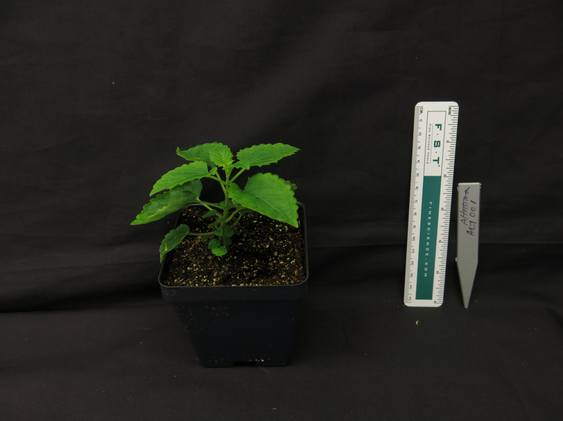
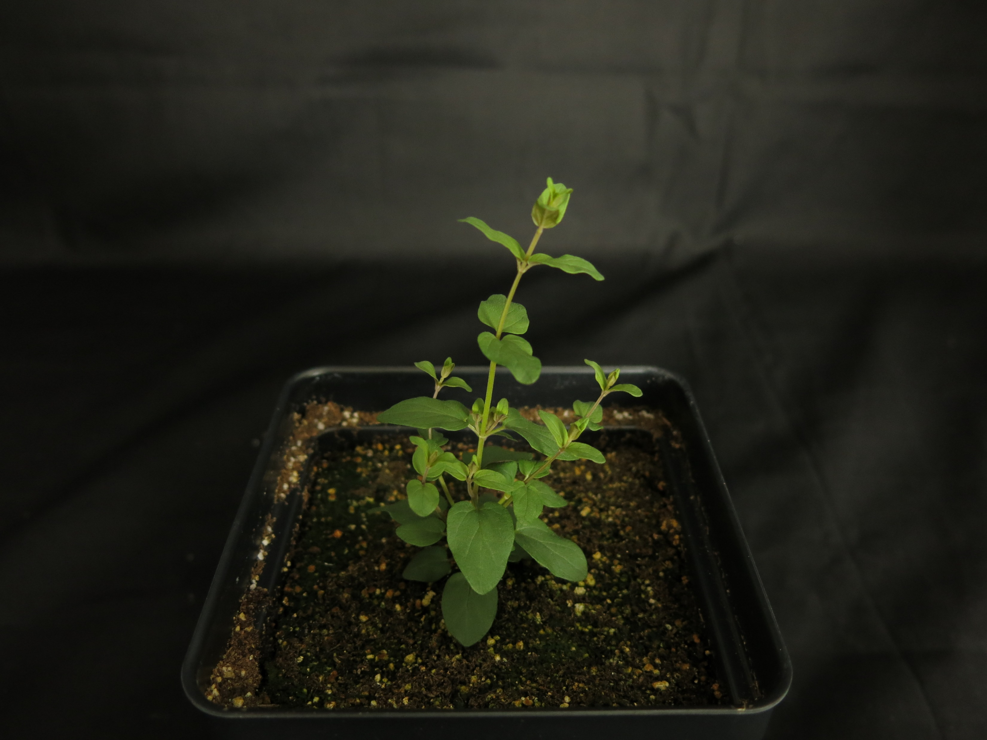
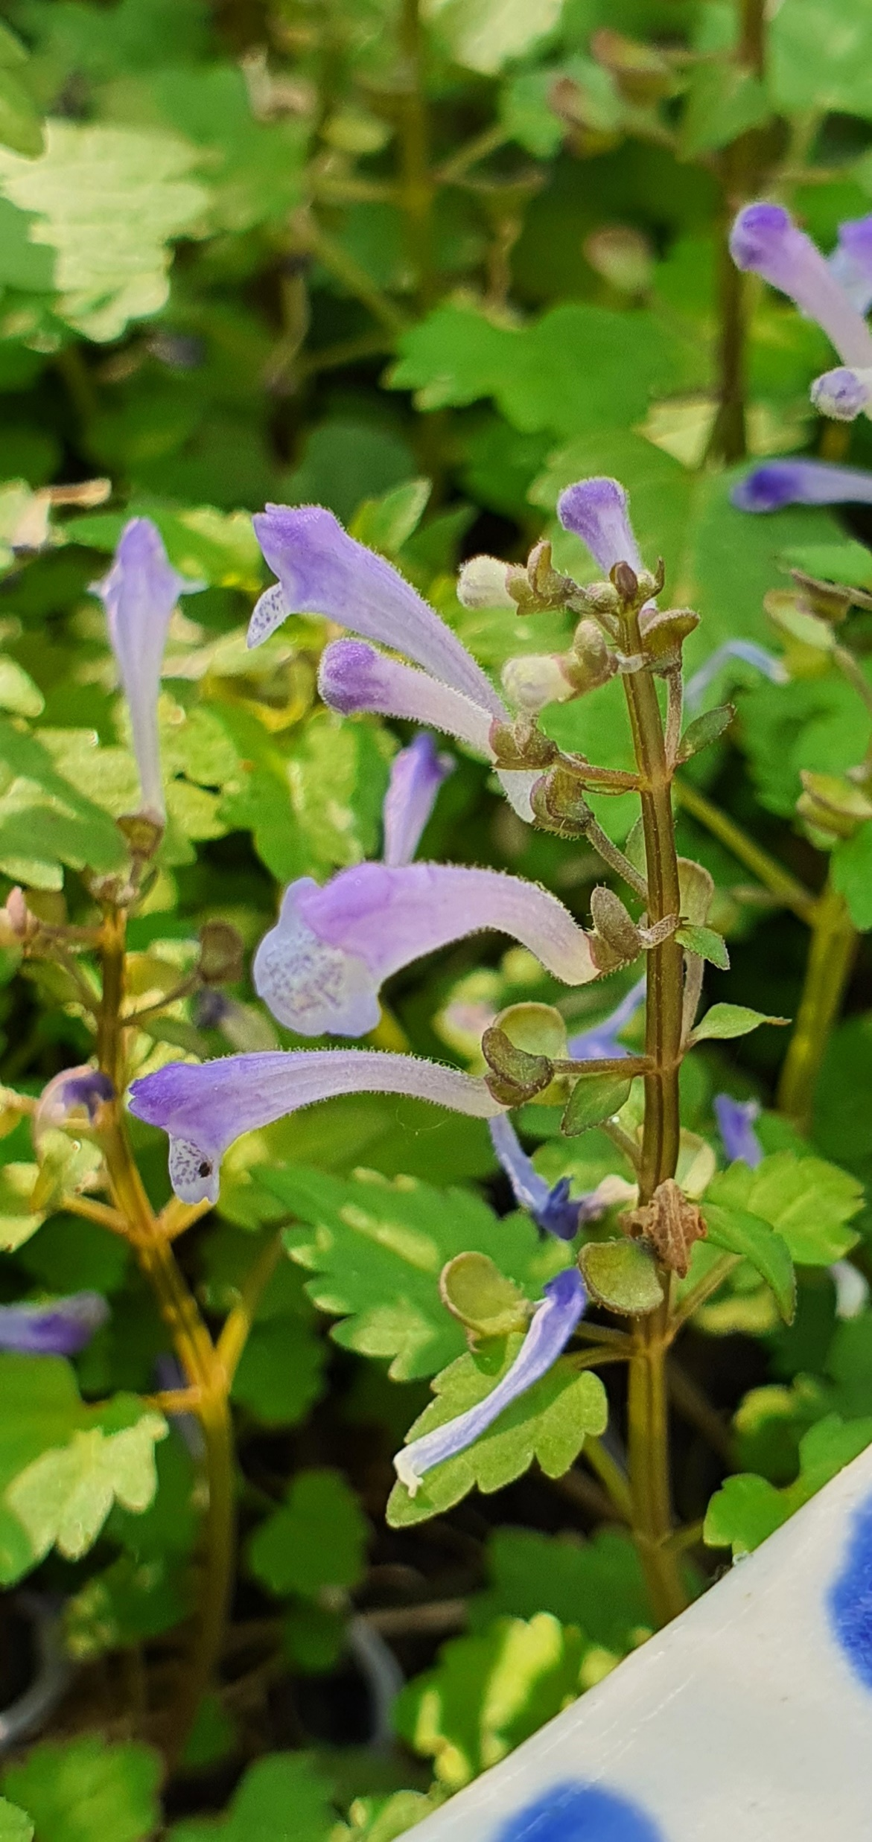
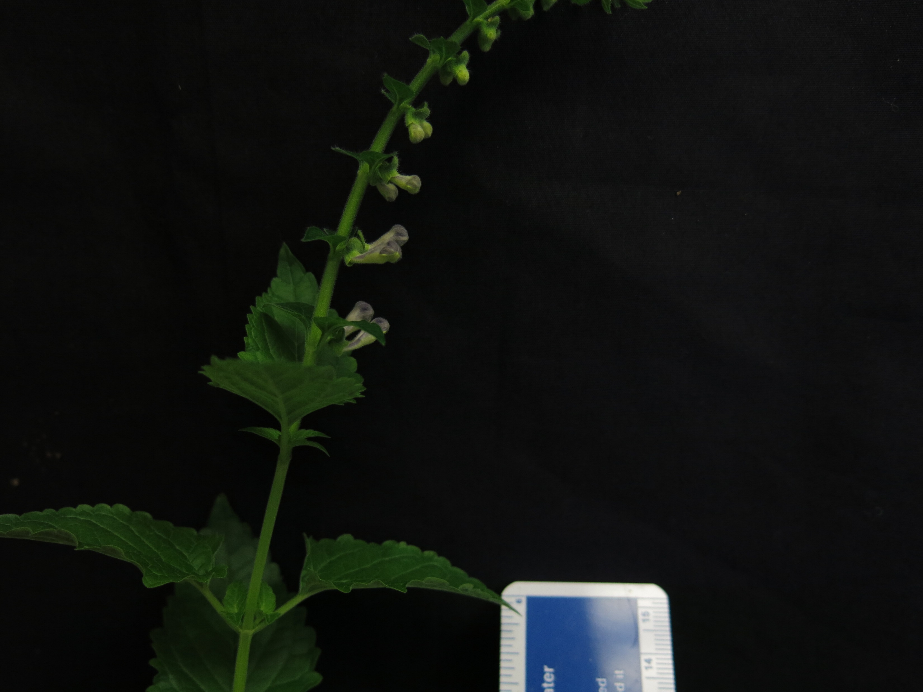
S. havanensis
S. insignis
S. indica var. coccinea
S. barbata
S. racemosa
S. strigillosa
S. dependens
S. wrightii
S. arenicola
S. baicalensis
S. tournefortii
S. altissima
S. leonardii
S. pekinensis var. alpina
Figure 3. Representative images of 14 species of Scutellaria selected for additional metabolite and genome size profiling. Scale bar in bottom left of images represents a length of 5 cm. Images without a scale bar did not have a ruler included in the image. Colored circles next to species names indicate the clade which the species belongs to, as indicated in Figure 1.

Slide 5
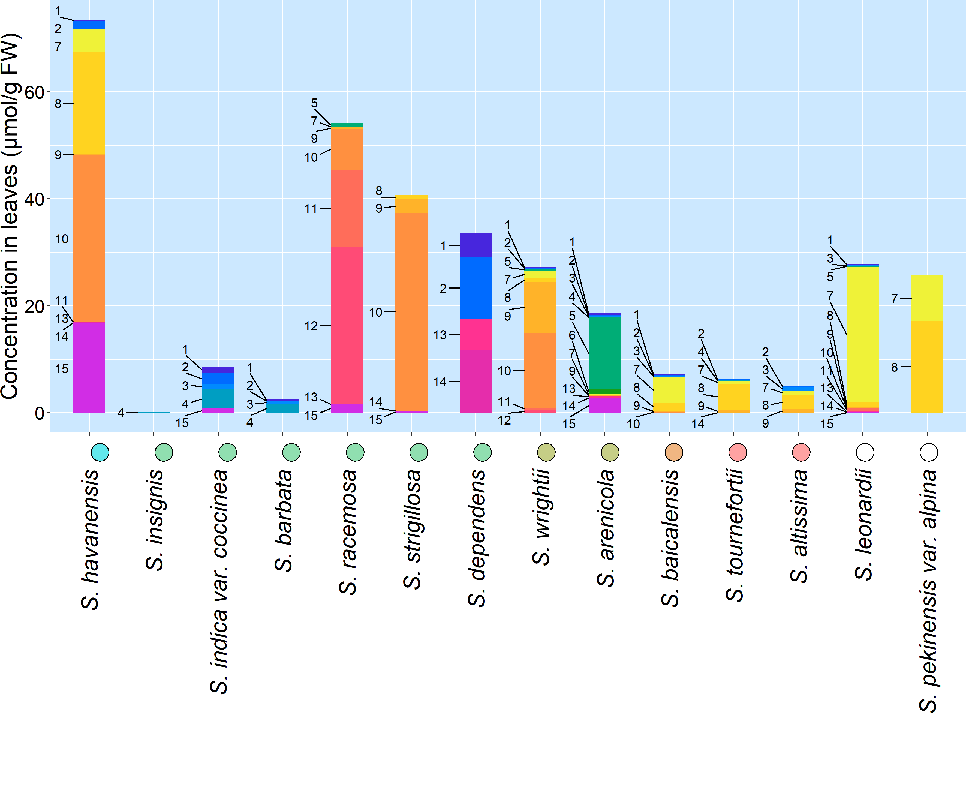
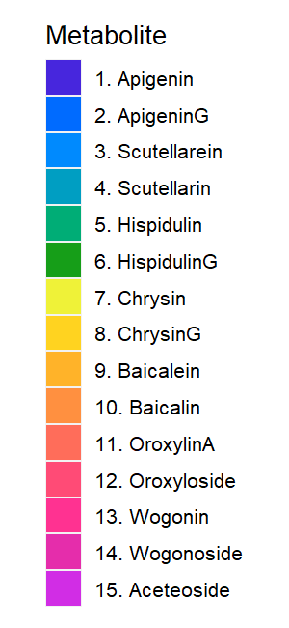
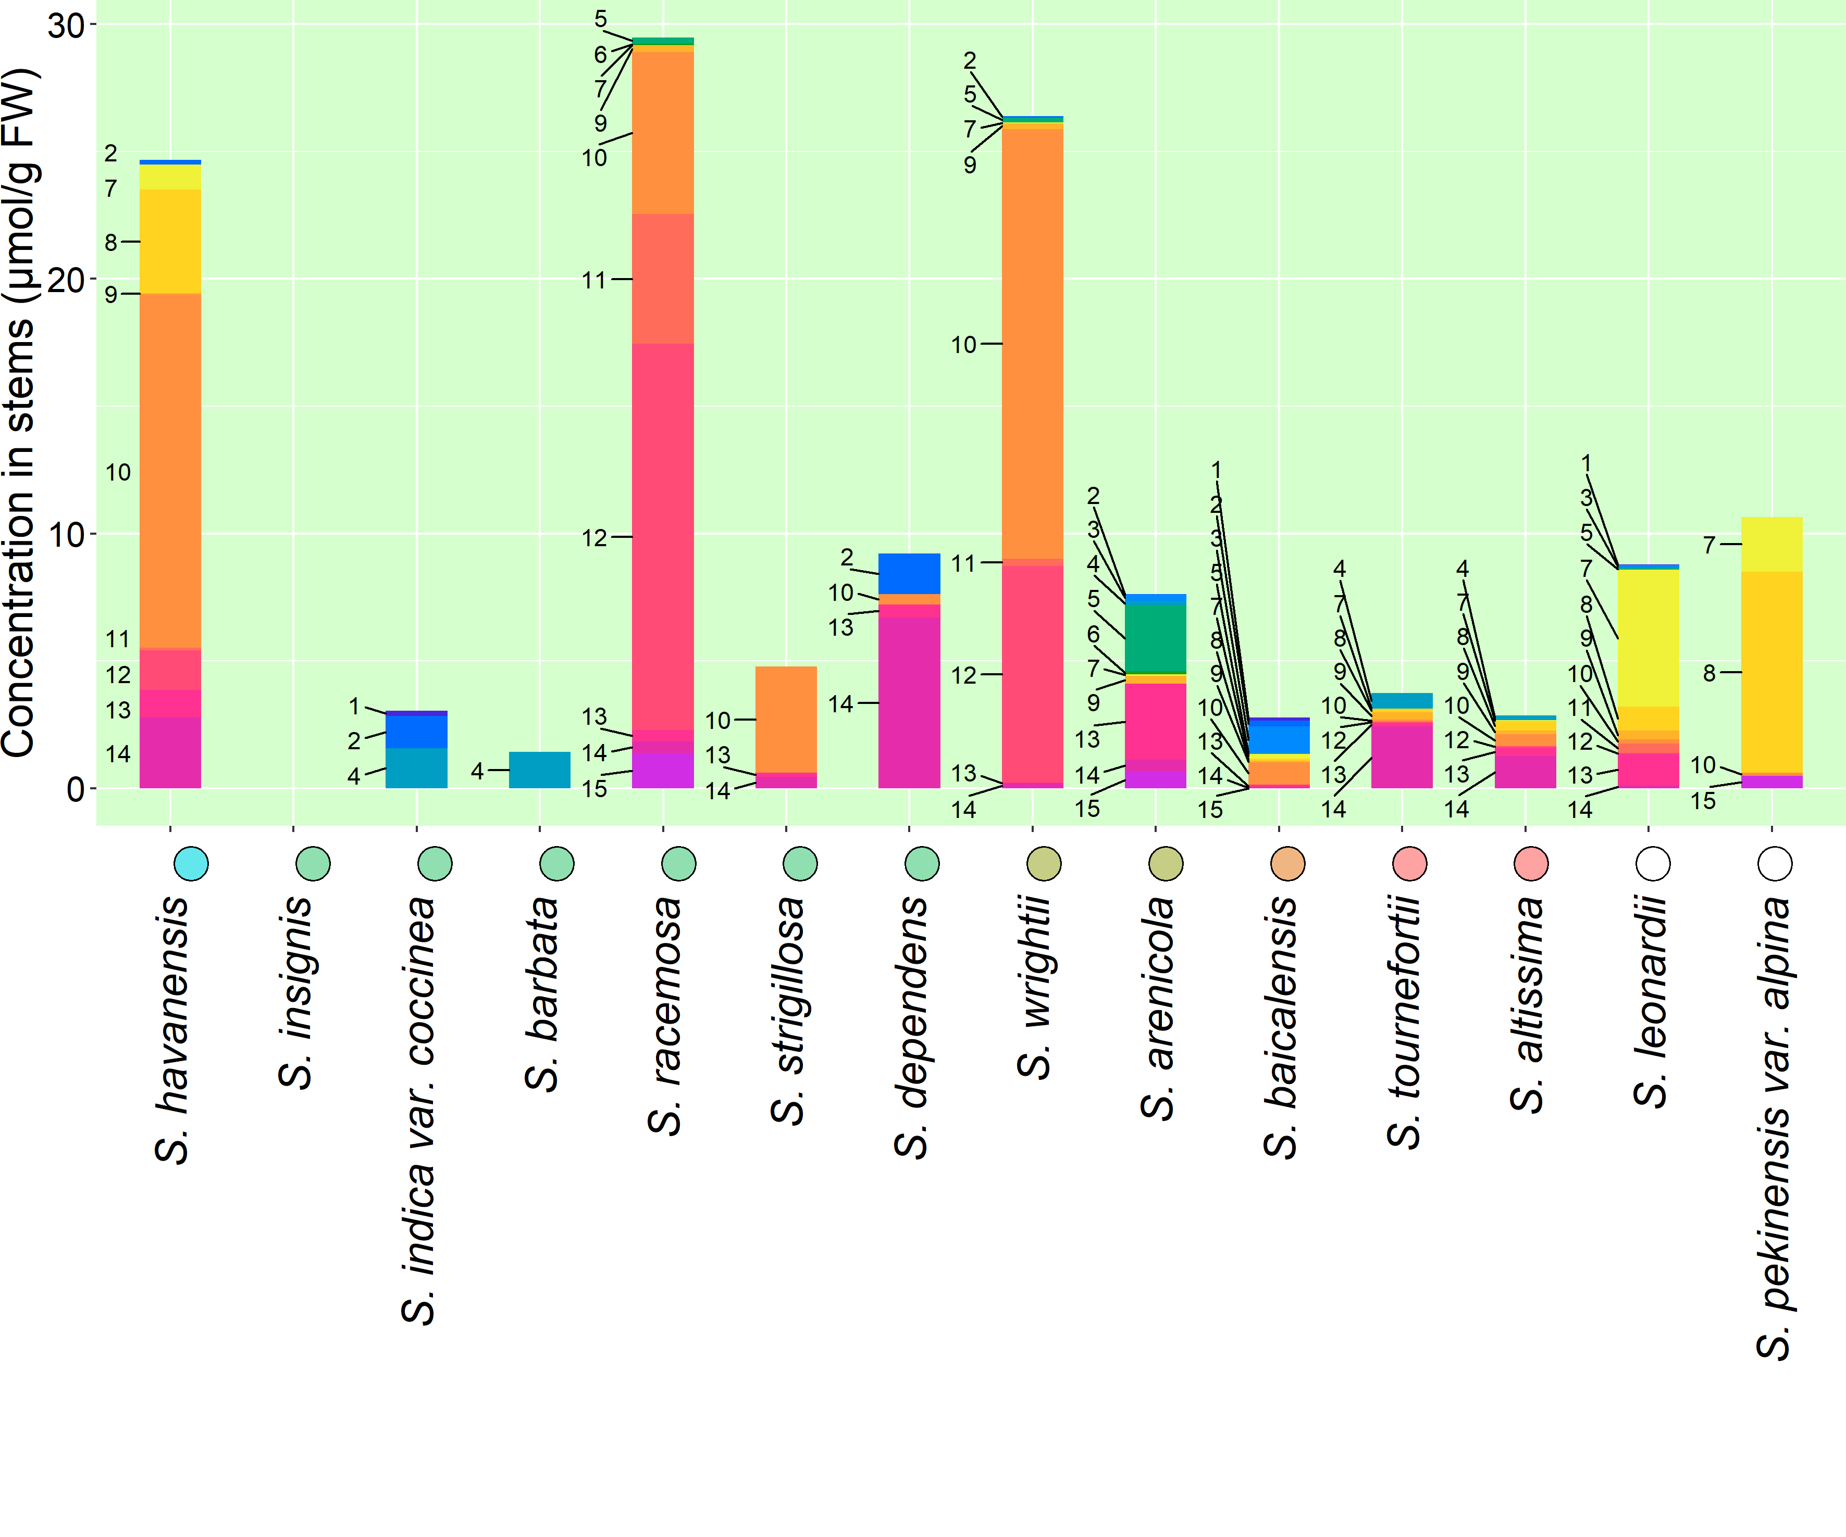
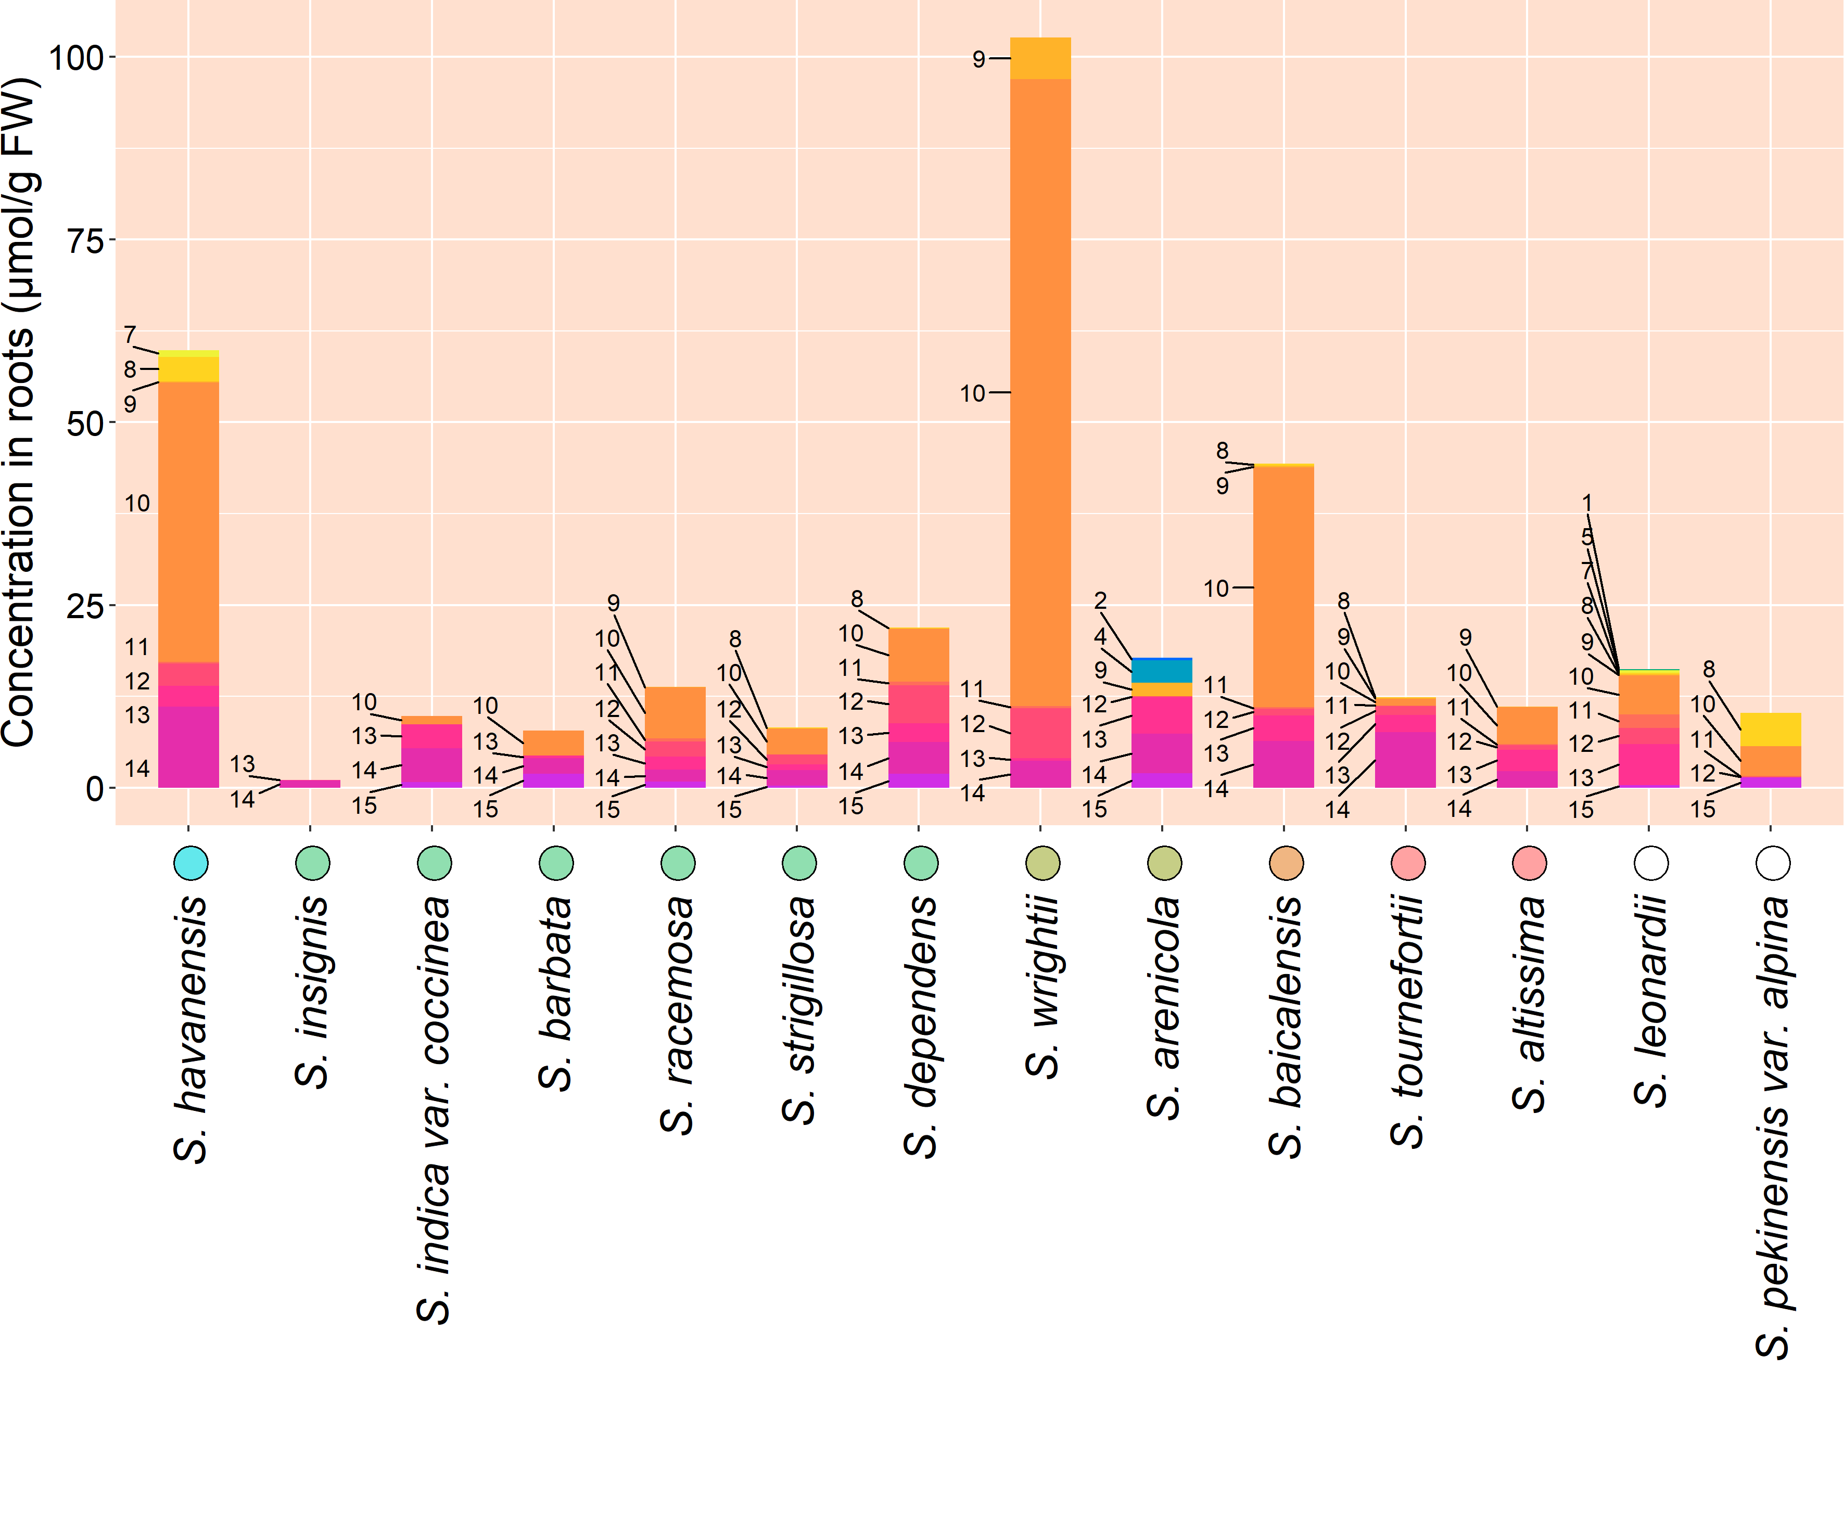
Figure 4. Organ-specific metabolite data collected from 14 Scutellaria species via High Performance Liquid Chromatography (HPLC). Data is shown in units of µmol/g fresh weight. Species on x-axis are ordered based on phylogenetic relationship determined from chloroplast genome data, and colored circles next to species names indicate phylogenetic clade, as shown in Figure 1. An empty circle indicates that the species was not included in the tree from Figure 1.

Slide 6
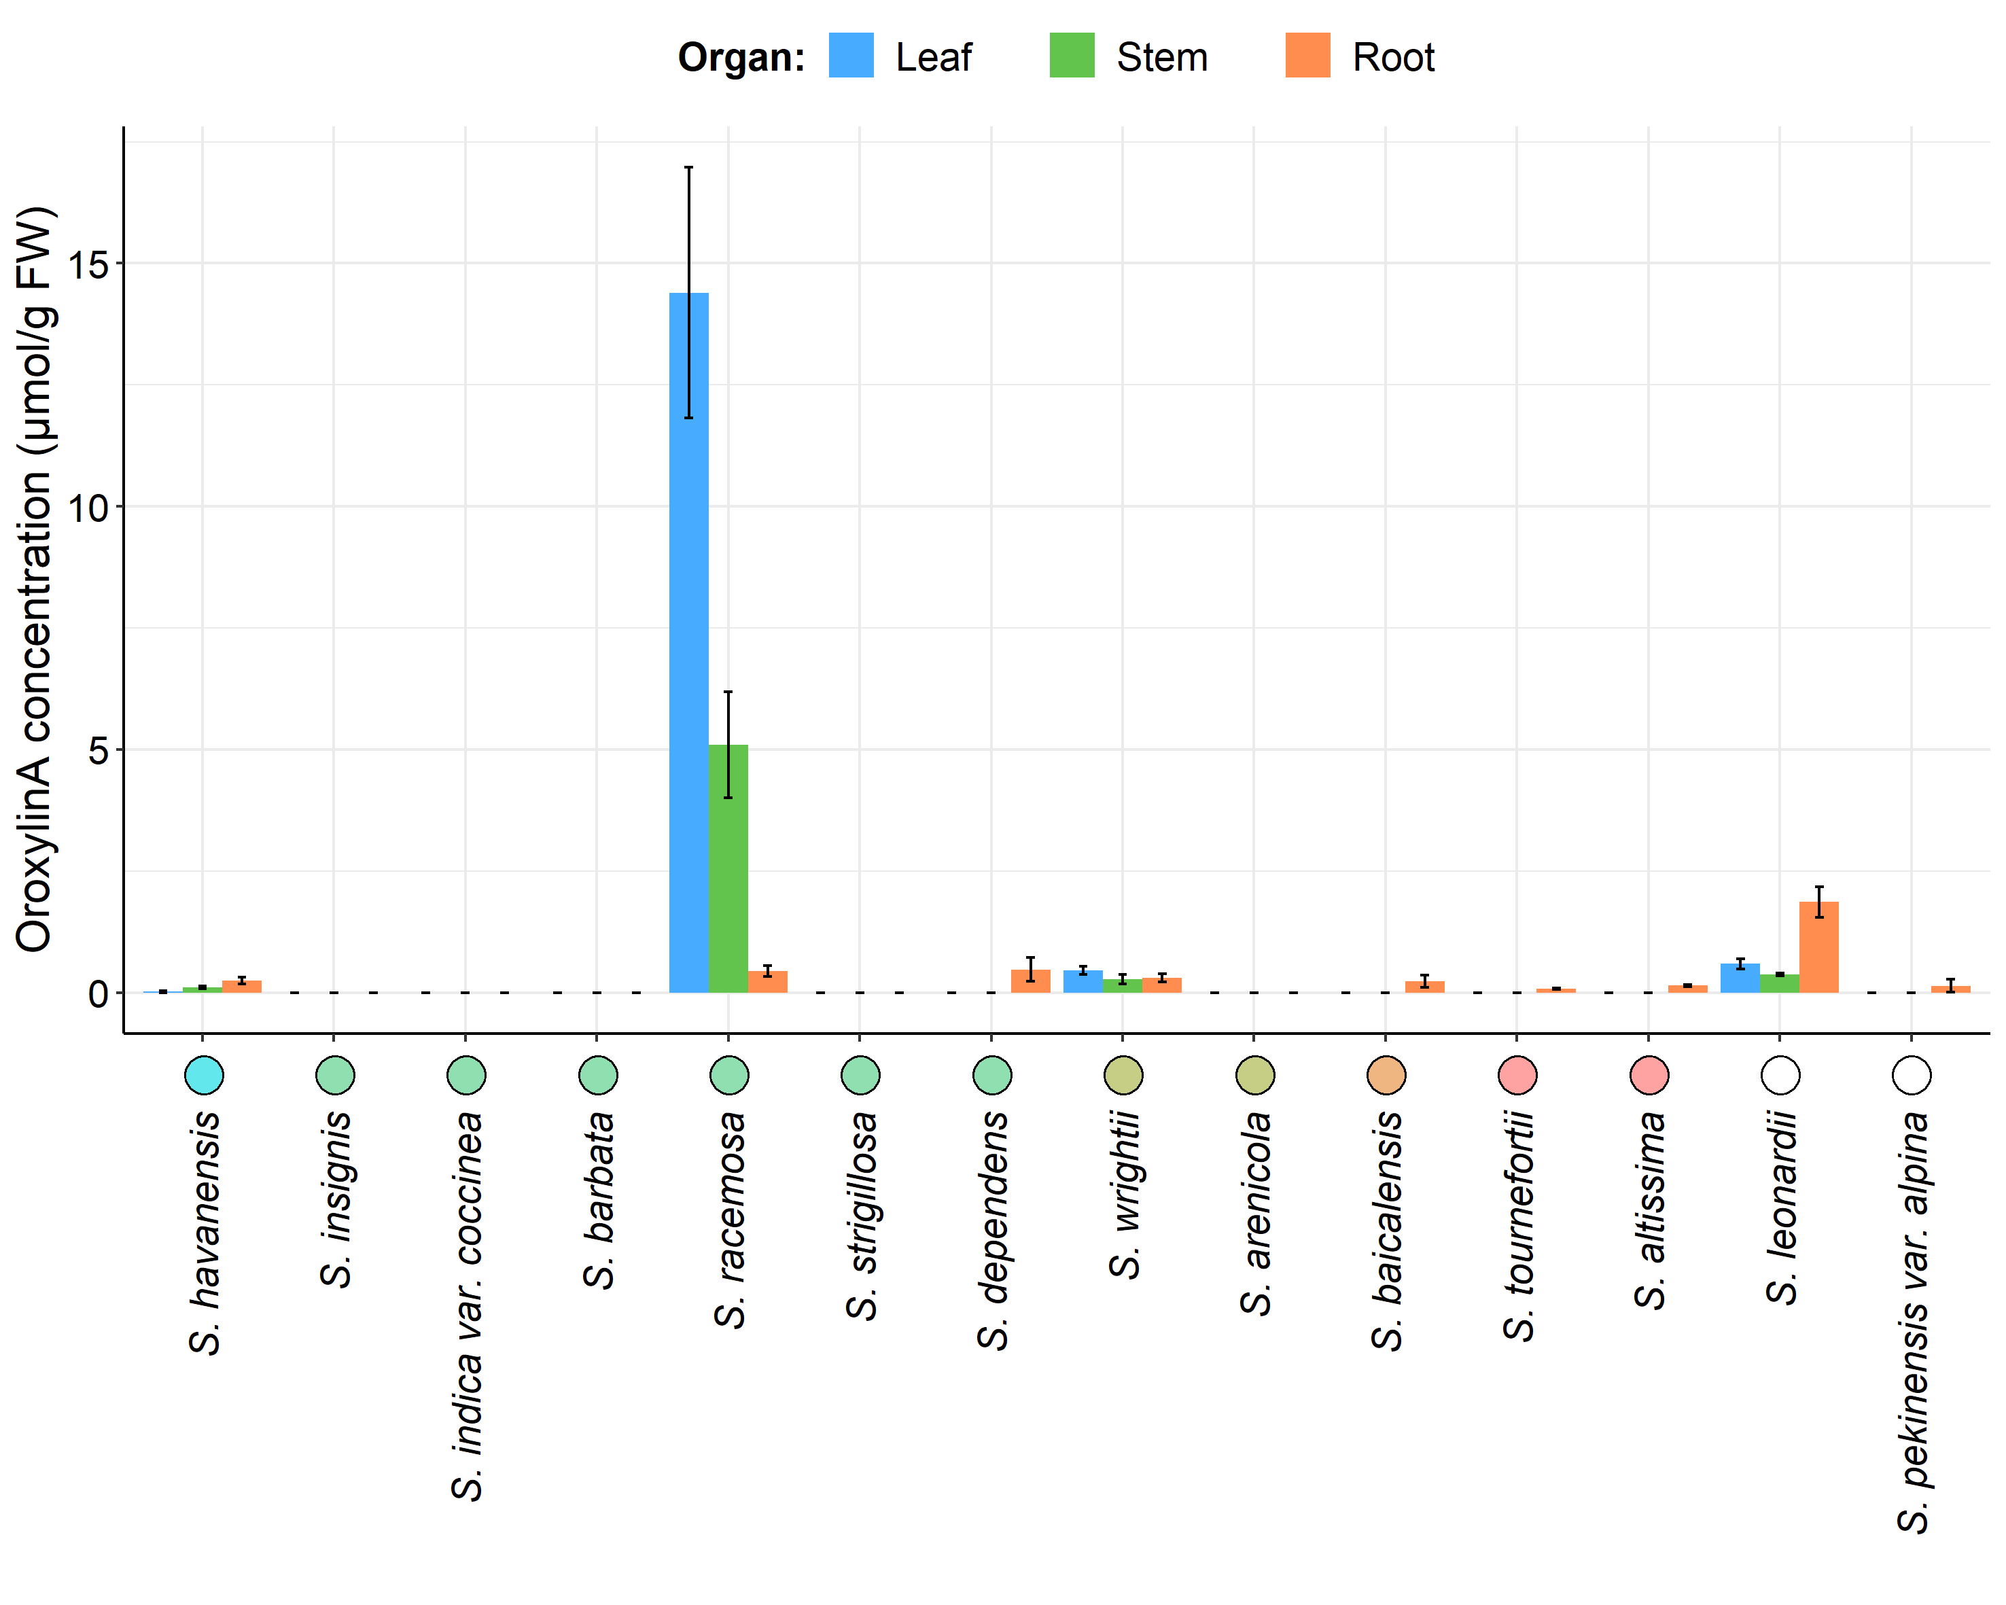
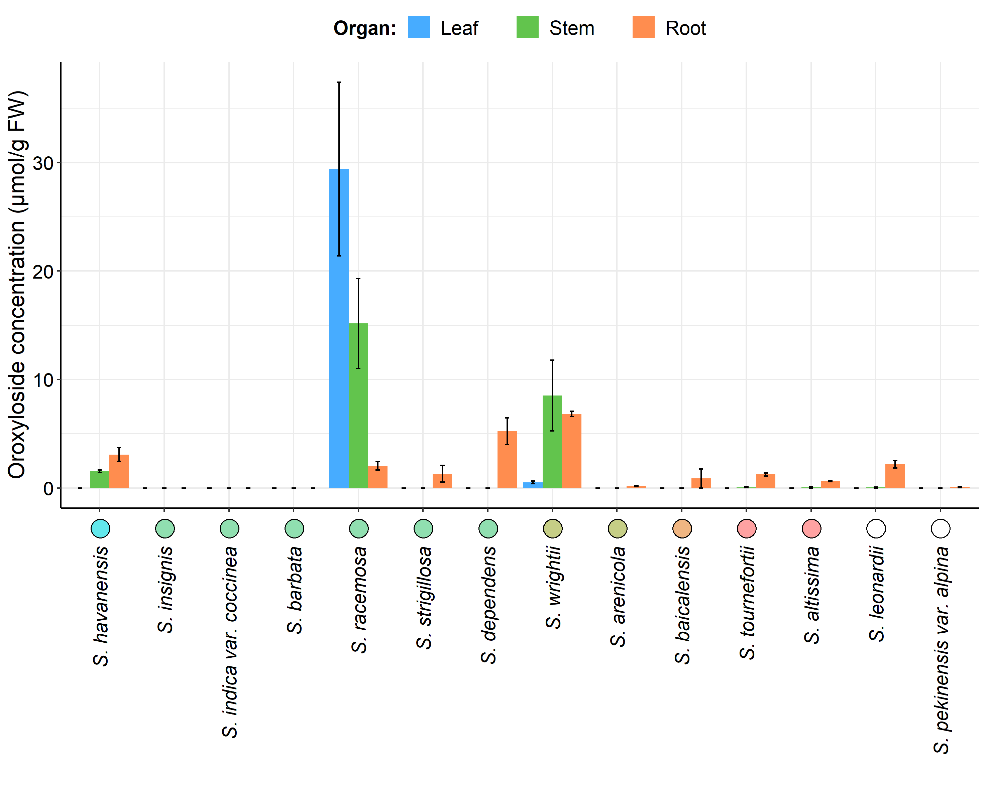
Figure 5. Organ-specific oroxylinA (bottom) and oroxyloside (top) concentrations in 14 Scutellaria species, as determined via High Performance Liquid Chromatography (HPLC). Data is shown in units of µmol/g fresh weight. Concentrations were averaged from tissue samples taken from 3 biological replicates, and error bars represent standard error. Species are ordered based on phylogenetic relationship determined from chloroplast genome data, and colored circles next to species names indicate phylogenetic clade, as shown in Figure 1. An empty circle indicates that the species was not included in the tree from Figure 1.

Slide 7
Table 1. Genome size and chromosome number data for 14 Scutellaria species. Genome sizes for 10 species were measured in this study using flow cytometry. Other genome size, and all chromosome number data was collected from literature. S. wrightii was not included in the flow cytometry procedure, and neither genome size nor chromosome data has been published. Cell colors indicate phylogenetic clade, as shown in Figure 1.
Species | Estimated genome size (Gbp) |  | Chromosome number
 | Measured in this study | Published previously | Published previously
S. havanensis | 0.37± 0.03
S. insignis |  | 0.46 (Lee & Kim, 2017)
S. indica var. coccinea |  | 0.38 (Lee & Kim, 2017)
S. barbata | 0.52 ± 0.03 | 0.35 (Xu et al., 2020) | 2n = 26 (Xu et al., 2020)
S. racemosa | 0.44 ± 0.03 | 0.37 (Cole et al., 2008) | 2n = 18 (Cole et al., 2008)
S. strigillosa |  | 0.38 (Lee & Kim, 2017)
S. dependens | 0.44 ± 0.01
S. wrightii
S. arenicola | 0.85 ± 0.02
S. baicalensis | 0.54 ± 0.00 | 0.38 (Xu et al., 2020) | 2n = 18 (Xu et al., 2020)
 |  | 0.41 (Zhao et al., 2019) | 2n = 18 (Zhao et al., 2019)
 |  | 0.41 (Cole et al., 2008)
S. altissima | 0.39 ± 0.02
S. tournefortii | 0.39 ± 0.01
S. leonardii | 0.50 ± 0.02
S. pekenensis var. alpina | 0.38 ± 0.02

Slide 8
Table S1. Herbarium information for all tissue samples used for metabolite measurements.
# | Species | Condition | Organ | Herbarium | Voucher label
1 | S. alpina | Dried | Leaf, stem | Steere Herbarium, NY, USA | T. H. Everett s. n. (NY)
2 | S. altissima | Dried | Leaf | Steere Herbarium, NY, USA | M. Churadze 1007 (NY)
3 |  | Fresh | Leaf, stem, root | To be submitted
4 | S. angulosa | Dried | Leaf | Steere Herbarium, NY, USA | K. M. Naid s. n. (NY)
5 | S. angustifolia | Dried | Leaf | Steere Herbarium, NY, USA | R. Olmstead 558 (NY)
6 | S. angustifolia ssp. micrathum | Dried | Leaf | Steere Herbarium, NY, USA | A. Tiehm 16758 (NY)
7 | S. antirrhinoides | Dried | Leaf | Steere Herbarium, NY, USA | N. D. Atwood 28625 (NY)
8 | S. arenicola | Dried | Leaf | University of Florida Herbarium, FL, USA | Paul Corogin SB104 (FLAS)
9 |  | Dried | Leaf | University of Florida Herbarium, FL, USA | D. B. Wand 6711 (FLAS)
10 |  | Fresh | Leaf, stem, root | To be submitted
11 | S. astinae | Dried | Leaf, stem | Steere Herbarium, NY, USA | J. T. Howell 38532 (NY)
12 | S. baicalensis | Fresh | Leaf, stem, root | To be submitted
13 | S. barbata | Fresh | Leaf, stem, root | Sungshin Herbarium, Seoul, Republic of Korea | S. Kim 2019-056 (SWU)
14 | S. blepharophylla | Dried | Stem | Steere Herbarium, NY, USA | G. B. Hinton 1086 (NY)
15 | S. brittonii | Dried | Leaf | Steere Herbarium, NY, USA | S. P. Churchill 7376 (NY)
16 | S. californica | Dried | Leaf | Steere Herbarium, NY, USA | R. Olmstead 434 (NY)
17 | S. coccinea | Dried | Leaf | Steere Herbarium, NY, USA | D. Cardenas et al. 42257 (NY)
18 | S. coerulea | Dried | Leaf | Steere Herbarium, NY, USA | T. S. Quedensley 10037 (NY)
19 | S. costaricana | Dried | Leaf, stem | Steere Herbarium, NY, USA | A. Cronquist 8834 (NY)
20 | S. dependens | Fresh | Leaf, stem, root | Sungshin Herbarium, Seoul, Republic of Korea | S. Kim 2019-065 (SWU)
21 | S. discolor | Dried | Leaf | Steere Herbarium, NY, USA | A. A. Bullock 740 (NY)
22 | S. drumondii | Dried | Stem | Steere Herbarium, NY, USA | L. C. Higgins 17229 (NY)
23 | S. elliptica | Dried | Leaf | University of Florida Herbarium, FL, USA | Nancy Coile 5213 (FLAS)
24 | S. epilobiifolia | Dried | Leaf, stem | Steere Herbarium, NY, USA | C. E. Garton 22860 (NY)
25 | S. formosa | Dried | Leaf, stem | Steere Herbarium, NY, USA | H. et al. 11073 (NY)
26 | S. fruticosa | Dried | Leaf | Steere Herbarium, NY, USA | H. Field & Y. Lazar s. n. (NY)
27 | S. galericulata | Dried | Leaf, stem | Steere Herbarium, NY, USA | D. Erskine & A. J. Smith 2118 (NY)
28 | S. glabriuscula | Dried | Leaf | Steere Herbarium, NY, USA | R. Kral s. n. (NY)
29 | S. guatemalensis | Dried | Stem | Steere Herbarium, NY, USA | D. Alvarez 11028 (NY)
30 | S. havanensis | Dried | Stem | Steere Herbarium, NY, USA | J. K. Small s. n. (NY)
31 |  | Fresh | Leaf, stem, root | To be submitted
32 | S. heydei | Dried | Leaf | Steere Herbarium, NY, USA | W. Koelz 6242 (NY)
33 | S. hispidula | Dried | Stem | Steere Herbarium, NY, USA | R. D. Worthington 12501 (NY)
34 | S. holmgreniorum | Dried | Leaf, stem | Steere Herbarium, NY, USA | G. Schoolcraft 1222 (NY)
35 | S. hookeri | Dried | Leaf, stem | Steere Herbarium, NY, USA | L. O. Willioms et al. 28585 (NY)
36 | S. incana | Dried | Leaf | Steere Herbarium, NY, USA | R. D. Thomas 150388 (NY)
37 | S. indica var. coccinea | Fresh | Leaf, stem, root | Sungshin Herbarium, Seoul, Republic of Korea | S. Kim & S. T. Lee 2015-0298 (SWU)
38 | S. insignis | Fresh | Leaf, stem, root | Sungshin Herbarium, Seoul, Republic of Korea | S. Kim 2015-0110 (SWU)
39 | S. integrifolia | Dried | Leaf | University of Florida Herbarium, FL, USA | Kimberely Gulledge 25 (FLAS)
40 | S. isocheila | Dried | Leaf, stem | Steere Herbarium, NY, USA | A. M. Brenes s. n. (NY)
41 | S. javalambrensis | Dried | Stem | Steere Herbarium, NY, USA | A. Charpin et al. s. n. (NY)
42 | S. javanica | Dried | Leaf | Steere Herbarium, NY, USA | S. K. Lau 1915 (NY)
43 | S. lateriflora | Dried | Leaf | Steere Herbarium, NY, USA | G. F. Buddell II 2352 (NY)
44 | S. leonardii | Dried | Stem | Steere Herbarium, NY, USA | J. C. Arthwz s. n. (NY)
45 |  | Fresh | Leaf, stem, root | To be submitted
46 | S. leptosiplonsipkon | Dried | Leaf | Steere Herbarium, NY, USA | L. Maplcoba s. n. (NY)
47 | S. longifolia | Dried | Leaf, stem | Steere Herbarium, NY, USA | J. J. Castillo & J. M. Vargas 2722 (NY)
48 | S. lutea | Dried | Stem | Steere Herbarium, NY, USA | Jorge A. Molina 30005 (NY)
49 | S. lutilaba | Dried | Leaf, stem | Steere Herbarium, NY, USA | Hinton et al. 21760 (NY)
50 | S. microphylla | Dried | Leaf, stem, root | Steere Herbarium, NY, USA | H. D. Ripley 14966 (NY)
51 | S. multicularis | Dried | Stem | Steere Herbarium, NY, USA | Assadi, Edmondson & Miller 2135 (NY)
52 | S. multiglandulosa | Dried | Leaf | Steere Herbarium, NY, USA | D. S. Correll & H. B. Correll 51703 (NY)
53 |  | Dried | Leaf | University of Florida Herbarium, FL, USA | Hillary M. Cherry 270 (FLAS)
54 | S. muriculata | Dried | Stem | Steere Herbarium, NY, USA | C. L. Lundell 14978 (NY)
55 | S. oblonga | Dried | Leaf | Steere Herbarium, NY, USA | L. H. Cramer 4871 (NY)
56 | S. orientalis | Dried | Leaf, stem | Steere Herbarium, NY, USA | E. Serowa & E. Ryschowa s. n. (NY)
57 | S. ovata | Dried | Leaf | Steere Herbarium, NY, USA | R. D. Thomas et al. 170488 (NY)
58 | S. parvula | Dried | Leaf, stem | Steere Herbarium, NY, USA | R. D. Thomas & C. Slaughter 103883 (NY)
59 | S. paucifolia | Dried | Stem | Steere Herbarium, NY, USA | P. Jaeger 8796 (NY)
60 | S. pekinensis var. alpina | Fresh | Leaf, stem, root | Sungshin Herbarium, Seoul, Republic of Korea | S. Kim 2015-0268 (SWU)
61 | S. peregrina | Dried | Leaf | Steere Herbarium, NY, USA | H. Field & Y. Lazar s. n. (NY)
62 | S. pinnatifida | Dried | Stem | Steere Herbarium, NY, USA | K. H. Rechinger 686 (NY)
63 | S. potosina | Dried | Leaf, stem | Steere Herbarium, NY, USA | D. S. Correll & H. B. Correll 30562 (NY)
64 | S. prostrata | Dried | Stem | Steere Herbarium, NY, USA | W. Koelz 21180 (NY)
65 | S. przewalskii | Dried | Stem | Steere Herbarium, NY, USA | L. Janczenko s. n. (NY)
66 | S. pseudoserrata | Dried | Leaf | Steere Herbarium, NY, USA | R. Kral s. n. (NY)
67 | S. pulchella | Dried | Root | Steere Herbarium, NY, USA | R. Schischkin et al. s. n. (NY)
68 | S. purpurascens | Dried | Stem | Steere Herbarium, NY, USA | A. M. Brenes s. n. (NY)
69 | S. racemosa | Dried | Stem | University of Florida Herbarium, FL, USA | s. n. (FLAS)
70 |  | Fresh | Leaf, stem, root | To be submitted
71 | S. relenorskyi | Dried | Leaf | Steere Herbarium, NY, USA | A. Donmez 3627 (NY)
72 | S. resinosa | Dried | Leaf, stem | Steere Herbarium, NY, USA | G. C. Freeman & R. E. Brooks 3682 (NY)
73 | S. sapphirina | Dried | Leaf, stem | Steere Herbarium, NY, USA | S. L. Welsh 20585 (NY)
74 | S. scordiifolia | Dried | Stem | Steere Herbarium, NY, USA | H. H. Iltis et al. 307 (NY)
75 | S. seleriana | Dried | Stem | Steere Herbarium, NY, USA | C. G. Pringle s. n. (NY)
76 | S. serrata | Dried | Leaf | Steere Herbarium, NY, USA | J. J. Carter s. n. (NY)
77 | S. siphocampuloides | Dried | Leaf, stem | Steere Herbarium, NY, USA | S. D. White 4380 (NY)
78 | S. splendens | Dried | Leaf | Steere Herbarium, NY, USA | A. Villegas H. 00063 (NY)
79 | S. strigillosa | Fresh | Leaf, stem, root | Sungshin Herbarium, Seoul, Republic of Korea | S. Kim 20140705 (SWU)
80 | S. suffrutscens | Dried | Stem | Steere Herbarium, NY, USA | J. L. Reveal 3390 (NY)
81 | S. sumatrana | Dried | Leaf | Steere Herbarium, NY, USA | C. Hamel & R. S. Toroes 767 (NY)
82 | S. tessellata | Dried | Leaf, stem | Steere Herbarium, NY, USA | R. D. Worthington 13323 (NY)
83 | S. tournefortii | Fresh | Leaf, stem, root | To be submitted
84 | S. wrightii | Fresh | Leaf, stem, root | To be submitted

